Slide 1




THE GLOBAL OPPORUNITITY YOUTH INITIATIVE
Accelerating Youth Economic Opportunity in India
Wednesday January 16, 10 am – 2 pm

Slide 2
Focus of the GOYI India learning visit
Bring together expert practitioners and youth working on youth employment:
1) Introduce GOYI and test local interest - collaborative, place based, systems approach
2) Understand the local youth employment context, bottlenecks, strengths, key ecosystem actors, opportunities
3) Identify potential solutions that could be accelerated to enable large scale impact on youth employment
4) Engage and learn from Opportunity Youth
#OpportunityYouthIndia
@AspenFCS
@GlobalDevInc
Notes:
Steve does introduction: why are we here?

Slide 3

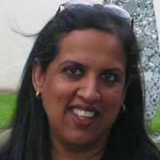
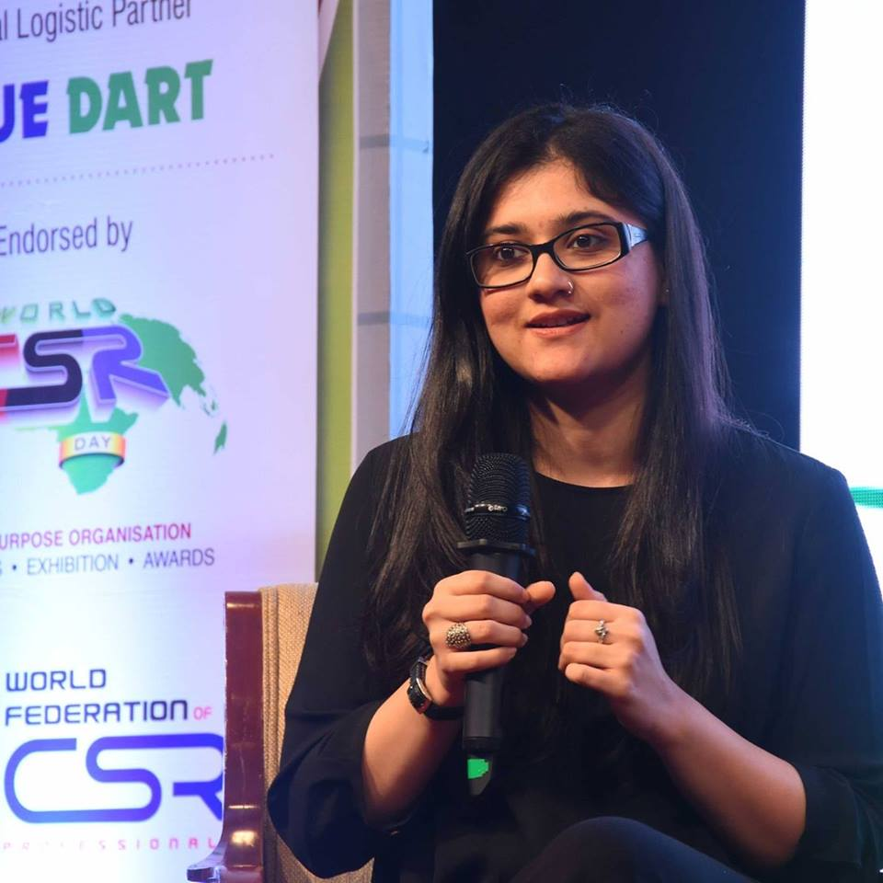
Welcome
Sarah Keh
Prudential
Jamie McAuliffe,
The Aspen Institute For Community Solutions
Alice Gugelev,
Global Development Incubator
Monique Miles,
The Aspen Institute For Community Solutions
Sangeeta Tyagi
YouthBuild International
Annu Mehta
Global Development Incubator
Tilly Josephson, Global Development Incubator

Slide 4
Agenda: Wednesday 16 January 2019
Time | Topics
10:00 AM – 10:15 AM | Welcome Introductions Agenda walk through
10:15 AM – 10:45 AM | The youth employment challenge in India National snapshot – JustJobs The private sector role in skilling - Samhita Social Ventures
10:45 AM – 11:15 AM | GOYI Initiative overview, approach and highlights
11:15 AM – 12:00 PM | Panel discussion Moderators: GDI & CAP YEI Panelists: CAP YEI UNDP , Restless Development, LabourNet, Michael and Susan Dell Foundation
12:00 PM – 1:45 PM | Brainstorming in groups Learning lunch Report backs
1:45 PM - 2:00 PM | Next steps & thank you
2:00 PM – 3:00 PM (Post program) | Session with youth Workshop participants welcome to stay

Slide 5
Agenda: Wednesday 16 January 2019
Time | Topics
10:00 AM – 10:15 AM | Welcome Introductions Agenda walk through
10:15 AM – 10:45 AM | The youth employment challenge in India National snapshot – JustJobs The private sector role in skilling - Samhita Social Ventures
10:45 AM – 11:15 AM | GOYI Initiative overview, approach and highlights
11:15 AM – 12:00 PM | Panel discussion Moderators: GDI & CAP YEI Panelists: CAP YEI UNDP , Restless Development, LabourNet, Michael and Susan Dell Foundation
12:00 PM – 1:45 PM | Brainstorming in groups Learning lunch Report backs
1:45 PM - 2:00 PM | Next steps & thank you
2:00 PM – 3:00 PM (Post program) | Session with youth Workshop participants welcome to stay

Slide 6

A global call to action to tackle youth unemployment
SDG8: “Promote sustained, inclusive and sustainable economic growth, full and productive employment and decent work for all”…with several specific target indicators focused on youth.
Increasing pressure
Limited scalable solutions
Population shifts, climate change, conflict and urbanization
Changing nature of work in the form of automation and digitization
Field is fragmented, no single solution/ “silver bullet”
Existing efforts reach a tiny fraction of youth in need
Limited awareness, coordination and financial support at level required
350M youth expected to be out of school,
unemployed or working in informal jobs

Slide 7
Vision and partners
Vision
Global opportunity youth have access to dignified, productive, and sustainable entrepreneurship and employment pathways.
Goals
Partner with communities around the world experiencing chronic unemployment to catalyze creation of 250,000+ economic opportunities for youth aged 15-29 who are out of school, unemployed, or working in informal jobs
Focus on “Opportunity Youth”
Timing
A 12 year program towards 2030, aligned with local development plans and sustainable development goals
Co-design Partners
Government (federal/state/local), education/schools
Youth and civil society groups
NGOs, research companies and for profits that provide training, services, advocacy
Corporates, SME and business associations, banks and investors
Private and community foundations, CSR activities

Slide 8
Sustainable and scalable economic opportunities: 6 pillars
1
2
3
Place-based Collaboration
Call To Action
Learning Agenda
Partner with community leaders to establish collaborative infrastructure
Provide a methodology and resources to co-design a 5-year program of work
Jointly lead a global campaign to raise awareness, increase investment and establish an asset-based narrative
Host communities of practice to promote practitioner knowledge sharing and innovation
Disseminate research, evidence and best practices
4
5
6
Youth Voice & Solutions
Funding Mobilization
Data & Digital Platforms
Engage OY in design and execution of solutions and leading community and global change efforts.
Mobilize global and local funders and diverse funding sources; grants, impact investing, innovative finance e.g. SIBs
Assist communities to build a business case for investment
Build community capacity adopt data-driven approaches
Accelerate digital platforms with potential to shift outcomes at mass

Slide 9




GOYI Design Partners (and expanding!)
The Aspen Institute’s Forum for Community Solutions promotes collaborative, community-based efforts that build the power and influence of those with the least access to opportunity. The Forum brings to GOYI experience and insight helping communities come together to eliminate systemic barriers and create their own solutions to their most pressing challenges
The Global Development Incubator (GDI) is a non-profit that builds startups and partnerships to address some of the world's toughest global development challenges. GDI brings to GOYI significant experience launching place-based multi-stakeholder initiatives as well as expertise in impact finance.
YouthBuild International is a global non-profit focused on unleashing the intelligence and positive energy of young people to transform their lives and rebuild their communities. YouthBuild International brings deep in-market experience to GOYI and excels in ensuring youth voice and agency influence solutions at every step of the process.
Prudential has, for many years, been a leading champion and funder of opportunity youth programming and initiatives in the United States. With GOYI, Prudential is bringing its substantial experience and global footprint to support global opportunity youth.

Slide 10
Who are “Opportunity Youth” and why do we focus on this population?
Core definition
Not included
Youth aged 15 – 29 who are not in education, employment or training (NEETS) or are informally employed
Primary focus:
  Coming from lower socio-economic status
  First time job seekers or first time entrepreneurs
  Transitions out of informal
Adults (35 and up)
Pre-adolescents
Upper middle income
Waged employees searching for a better opportunity or upskilling to higher wages
An asset-based framing that recognizes the systemic, rather than individual, nature of challenges these youth face

Slide 11
Cross-sector analysis and participation - no one actor can solve the problem
Supply
  Livelihood development
  Entrepreneurship training
  Secondary Public/private schools
  TVET centers
  Innovation hubs and Youth centers
  Soft skills training
  Career development
  As an employer (in schools and programs)
Youth
  Youth created hubs and programs
Youth numbers, current and future
Segmentation by socio-economic, gender, age, school, certifications
Aspirations
Journeys and profiles
Civil society groups
Gender analysis
Community and family analysis
As an employer
  Public School budgets
  Curricula
  Funds for vocational centers
  Matching programs
  Business run schools,
  Work learn programs
  Tax incentives
  Stimulus packages
  Economic zones
  Economic growth and macro trends
  Sector, industry and geographic size, growth and expected demand for labor (including corporate and SME)
  Detailed review of skilled/unskilled, certification required by sector
  Business ecosystems and clusters, value chains
  Livelihood/artisan connection to markets
  Voting/civic engagement
  Largest employer
  Policy
  Budgeting
  Macro investing
  Incentives/tax regulations
Government
Demand
Funders, Researchers and Field Builders
Foundations
Universities
Bi-laterals, global agencies
Research organizations
Consulting Companies

Slide 12
Co-design approach - Proposed 4 step approach rooted in local context and priorities
1. Align
on long-term community vision youth profiles, geographic scope
2. Map
systems, assets, interventions, stakeholders
3. Target
growth industries, labor market opportunities
4. Accelerate & Scale
place based interventions
Build on what exists and ensure approach is locally driven
“Bottom-up”, inclusive design approach
Youth engaged at each step

Slide 13
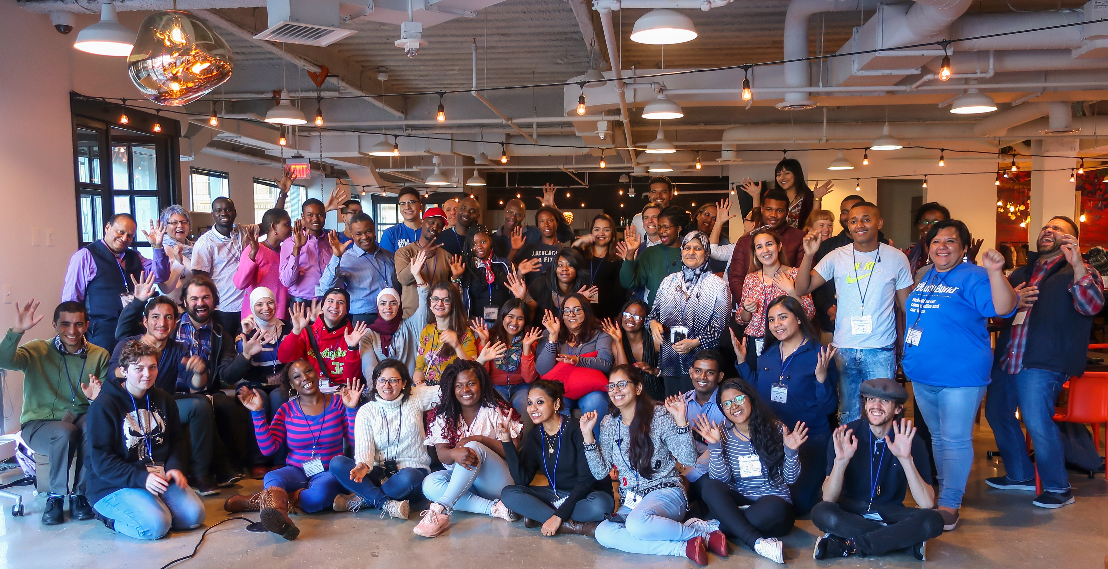
GOYI Global Opportunity Youth Summit 2019
The Global Opportunity Youth Leadership Network
“Nothing about us without us”
Sustained channels for youth input and feedback in strategy development and program delivery
Youth capacity building
International youth learning network

Slide 14
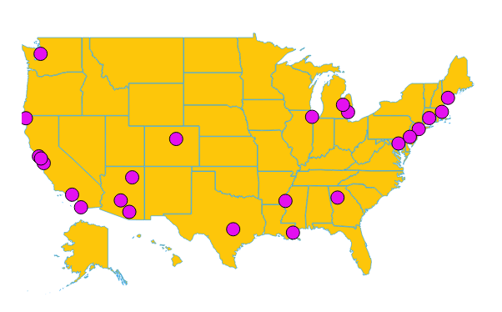
The Aspen Forum for Community Solutions OY Forum
A network of 26 rural and urban collaboratives that work on creating systems-wide and community level changes to achieve better outcomes in education and employment for 6.7M opportunity youth in The United States.
Approach
Build and strengthen collaborative infrastructure
Diverse multi-stakeholder commitment
Instigate and sustain collective action
Youth as an asset
Results
Youth leadership
Policy change
Nearly 100,000 directly reached
+110 M in private and public funds mobilized

Slide 15
Community selection and activation process
Selection Criteria
Pathways
Communities
Need: high # and % of under/unemployment youth
System readiness
Critical stakeholders
Outsized impact – location has broader influence
Round 1 activation
First half of 2019
Round 2 activation
Second half of 2019 or 2020
1. Bogota, Colombia
2. Mombasa, Kenya
3. Pune, India
4. Sao Paulo, Brazil
5. Jharkhand, India
6. Johannesburg, South Africa
7. Guanajuato, Mexico

Slide 16






2018-19 community activation and site visits
2018 - comparative study of 180 countries with deep analysis of top 30 and field visits to validate
2019 - selected 3 pilot communities to implement and adapt approach with aim to expand the network to include dozens of communities by 2030
COMMUNITY VISIT LOCATION
MONTH
August | September | October | November
Jordan
Brazil
Mexico (Potential)
South Africa
Pune & Jharkhand
Mombasa
25-30
12-21
15-19
18-22
11-15
18-21
2-6

Slide 17
Anchor Partner Selection Criteria
GOYI values alignment
Capabilities
Committed to central pillar of authentic youth engagement
Scale mindset
Deeply open to learning, innovation
Pathways thinker
Trusted convener and long term local presence
Data and performance measurement orientation
Systems leadership
Policy and advocacy
Key role to facilitate effective cross-sector collaboration and drives partner commitment, action, and learning

Slide 18
Agenda: Wednesday 16 January 2019
Time | Topics
10:00 AM – 10:15 AM | Welcome Introductions Agenda walk through
10:15 AM – 10:45 AM | The youth employment challenge in India National snapshot – JustJobs The private sector role in skilling - Samhita Social Ventures
10:45 AM – 11:15 AM | GOYI Initiative overview, approach and highlights
11:15 AM – 12:00 PM | Panel discussion Moderators: GDI & CAP YEI Panelists: CAP YEI UNDP , Restless Development, LabourNet, Michael and Susan Dell Foundation
12:00 PM – 1:45 PM | Brainstorming in groups Learning lunch Report backs
1:45 PM - 2:00 PM | Next steps & thank you
2:00 PM – 3:00 PM (Post program) | Session with youth Workshop participants welcome to stay
Notes:
Official Program
10:00 – 10:15 am: Welcome and introduction
10:15 - 10:45 am: Youth unemployment challenge in India / overview of the sector
10:45 - 11:15 am: GOYI Initiative overview, approach and highlights
11:15 - 12:00 pm: Leadership panel (Alice Gugelev + Nalini Gangadharam as co-moderators)
12:00 - 1:45 pm: Brainstorming workshop/learning lunch and report backs
1:45 - 2:00 pm: Next steps and thank you

Slide 19
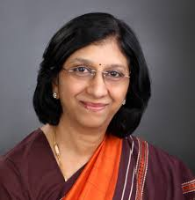



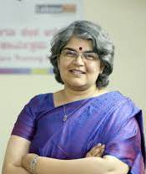
Panel discussion
Alice Gugelev
Global Development Incubator
Nalini Gangadharan
CAP YEI
Nalini Paul
Restless
Development
Clement Chauvert
United Nations Development Program
Rahil Rangwala
Michael and Susan
Dell Foundation
Gayathri Vasudevan
LabourNet

Slide 20
Agenda: Wednesday 16 January 2019
Time | Topics
10:00 AM – 10:15 AM | Welcome Introductions Agenda walk through
10:15 AM – 10:45 AM | The youth employment challenge in India National snapshot – JustJobs The private sector role in skilling - Samhita Social Ventures
10:45 AM – 11:15 AM | GOYI Initiative overview, approach and highlights
11:15 AM – 12:00 PM | Panel discussion Moderators: GDI & CAP YEI Panelists: CAP YEI UNDP , Restless Development, LabourNet, Michael and Susan Dell Foundation
12:00 PM – 1:45 PM | Brainstorming in groups Learning lunch Report backs
1:45 PM - 2:00 PM | Next steps & thank you
2:00 PM – 3:00 PM (Post program) | Session with youth Workshop participants welcome to stay

Slide 21
Brainstorming instructions
12pm-12:15pm
Pick up lunch and join a table
Mix up tables – do not sit with your colleagues and ensure 2-3 youth at every table
12:15pm-1:15pm
Identify group spokesperson (if possible, ideally young person)
Review questions and write down ideas
Ensure youth voice is represented in discussion and in solutions
1:15pm-1:45pm
Start at 1:15pm sharp to share back ideas from all groups
Engage in short discussion

Slide 22
Brainstorm: 1 HOUR (12:15-1:15pm)
Part 1: Set-up (15 minutes until 12:30pm)
Make sure group is mixed (no colleagues from same company, 2-3 young persons)
Identify spokesperson to present findings, try to keep structured and to 2-3 minutes summaries
Briefly introduce yourself and your model/expertise with your table and the role you play in youth employment in India (15 minutes)
Part 2: Brainstorming (45 minutes until 1:15pm ‘sharp’)
Questions
Consider <community> – would a place-based approach work to focus city youth employment efforts? At what level e.g. States, city, district)? Are there particular locations / areas with a lot of strong programs and support? Are there particular areas where where the need is high but are neglected?
What are the most impactful local interventions that could be scaled to achieve population-wide impacts?
What growth sectors and industries have the highest potential to create opportunities for youth? e.g. construction, ICT, manufacturing. What would incentivize employment of opportunity youth?
Which systems most require shifting? e.g. government policy, corporate behavior, funders and investor behavior, societal attitudes?
Who has to be at the table for systems change to happen? Please identify specific corporates, civil society, government departments. How could we engage these organizations in a coordinated ecosystem approach?
Which youth populations have been hard for existing programs to engage? What changes could be made to give these populations more access to supports?

Slide 23
Agenda: Wednesday 16 January 2019
Time | Topics
10:00 AM – 10:15 AM | Welcome Introductions Agenda walk through
10:15 AM – 10:45 AM | The youth employment challenge in India National snapshot – JustJobs The private sector role in skilling - Samhita Social Ventures
10:45 AM – 11:15 AM | GOYI Initiative overview, approach and highlights
11:15 AM – 12:00 PM | Panel discussion Moderators: GDI & CAP YEI Panelists: CAP YEI UNDP , Restless Development, LabourNet, Michael and Susan Dell Foundation
12:00 PM – 1:45 PM | Brainstorming in groups Learning lunch Report backs
1:45 PM - 2:00 PM | Next steps & thank you
2:00 PM – 3:00 PM (Post program) | Session with youth Workshop participants welcome to stay

Slide 24
Agenda: Wednesday 16 January 2019
Time | Topics
10:00 AM – 10:15 AM | Welcome Introductions Agenda walk through
10:15 AM – 10:45 AM | The youth employment challenge in India National snapshot – JustJobs The private sector role in skilling - Samhita Social Ventures
10:45 AM – 11:15 AM | GOYI Initiative overview, approach and highlights
11:15 AM – 12:00 PM | Panel discussion Moderators: GDI & CAP YEI Panelists: CAP YEI UNDP , Restless Development, LabourNet, Michael and Susan Dell Foundation
12:00 PM – 1:45 PM | Brainstorming in groups Learning lunch Report backs
1:45 PM - 2:00 PM | Next steps & thank you
2:00 PM – 3:00 PM (Post program) | Session with youth Workshop participants welcome to stay

