Slide 1

Welcome
Notes:
Welcome remarks by GDI James, CRS Representative Hussein

Slide 2
Global Opportunity Youth Network (GOYN)
MEAL WORKSHOP
17th and 26th August 2021
Emmanuel Olela
Phoebe Owino

Slide 3
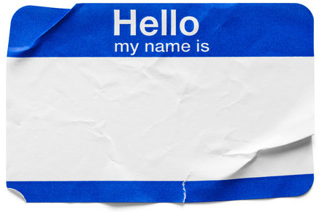
Introductions
Workshop objectives/agenda
Participant Name, Organization, Role
Welcome
Introduction to MEAL
Project design: Problem and Solution trees
Theory of Change
Results framework
Logical framework
Reporting
Photography
Notes:
Introduction: GDI, CRS and Participants (Go by group starting with - Amazing persons with disabilities, Green spaces, Ololoo youth hub initiative, Bahari Community Empowerment center, Kadzandani Creative Youth Organization, Monica Kahenda)

Slide 4
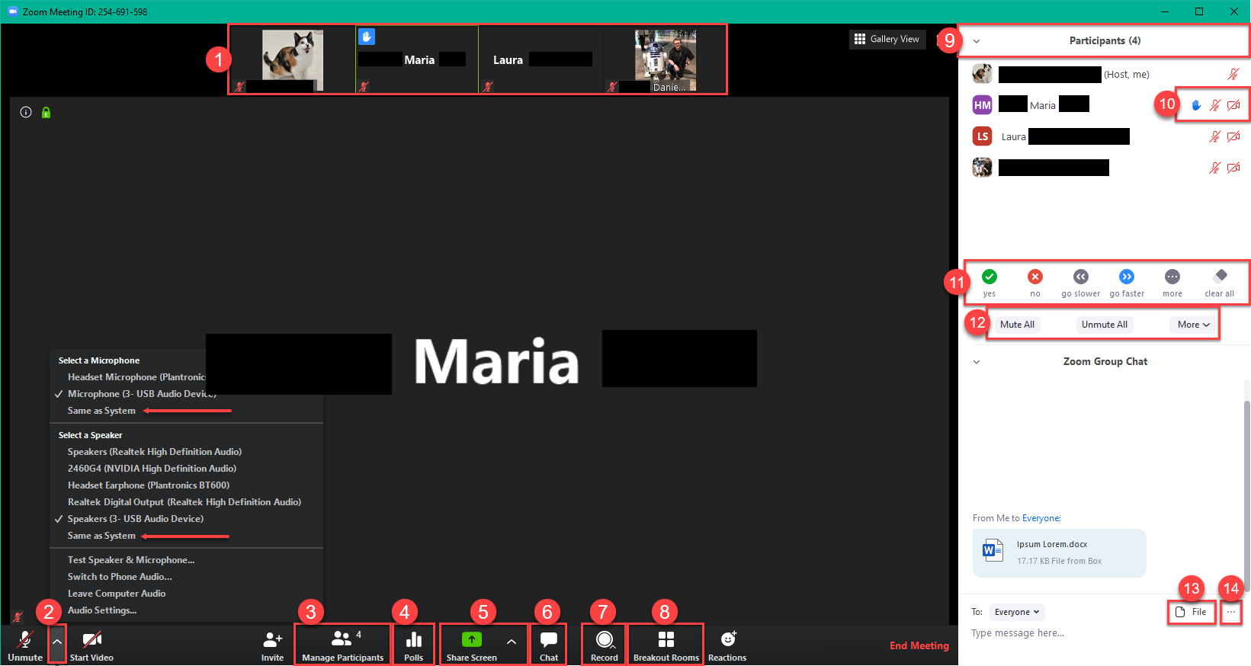
Zoom meeting basics and norms
Notes:
We will have workshop norms and guidelines just like any other ordinary workshops we have attended before. I understand we are joining individually from personal computers. Which is good for the two sessions. So, the following will be our virtual norms and guide; a) whenever you have a comment/question or feedback use the chat icon #4 and type in the chat box, b) Always keep your mic(rophone) muted #2. This will help the participants hear clearly what is being presented and also reduce background interference.

Slide 5
Introduction to MEAL

Slide 6
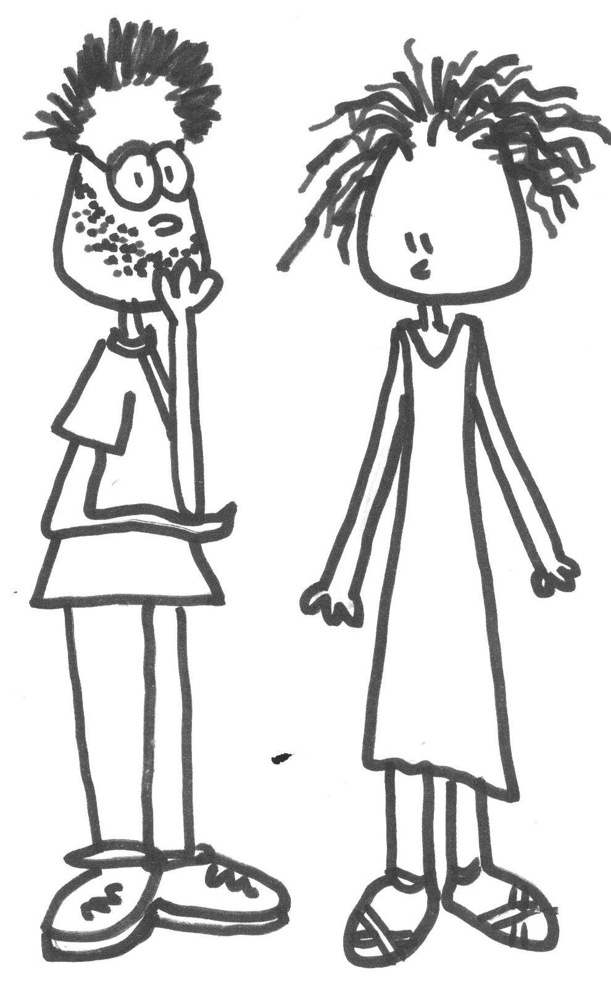
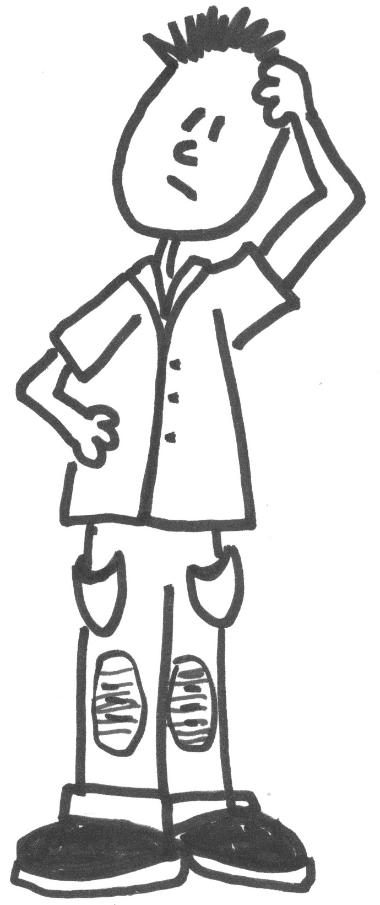
What is MEAL?
What is Evaluation?
What is Monitoring?
How we measure whether our project is on the road to reaching its objectives (monitoring) or has actually reached its objectives (evaluation) – or not.
What is Accountability?
What is Learning?

Slide 7
Defining MEAL
Monitoring | Evaluation | Accountability | Learning
Systematic collection, analysis and documentation of information about progress towards achieving project objectives in order to inform timely decision making and contribute to project accountability and learning. | Periodic, systematic assessment of a project’s relevance, efficiency, effectiveness, impact and sustainability on a defined population. | How an organization responds to and balances the needs of all stakeholders (including beneficiaries, donors, partners and CRS itself) in its decision making and activities and delivers against this commitment. | Continuous process of analyzing a wide variety of information sources and knowledge (including evaluation findings, monitoring data, innovations, stories, person-to-person exchanges and new learning) that bring to light new best practices or call into question received wisdom.
Notes:
Monitoring: This changes in operational contexts
Evaluation: Evaluation draws from data collected via the monitoring system, as well as any other more detailed data (e.g., from additional surveys or studies) gathered to understand specific aspects of the project in greater depth.
Learning: Leads to iterative adaptation of project design steps, the project strategy and/or project implementation, in order to sustain the most effective and efficient path to achieving project success.

Slide 8
Why MEAL?
It makes us accountable.​
It helps us learn how to do things better.​
Improves the quality of what we are doing.​
It makes reporting to donors & other stakeholders much easier.​
It is another opportunity to engage participants.​
It will increase the chances of future funding.

Slide 9
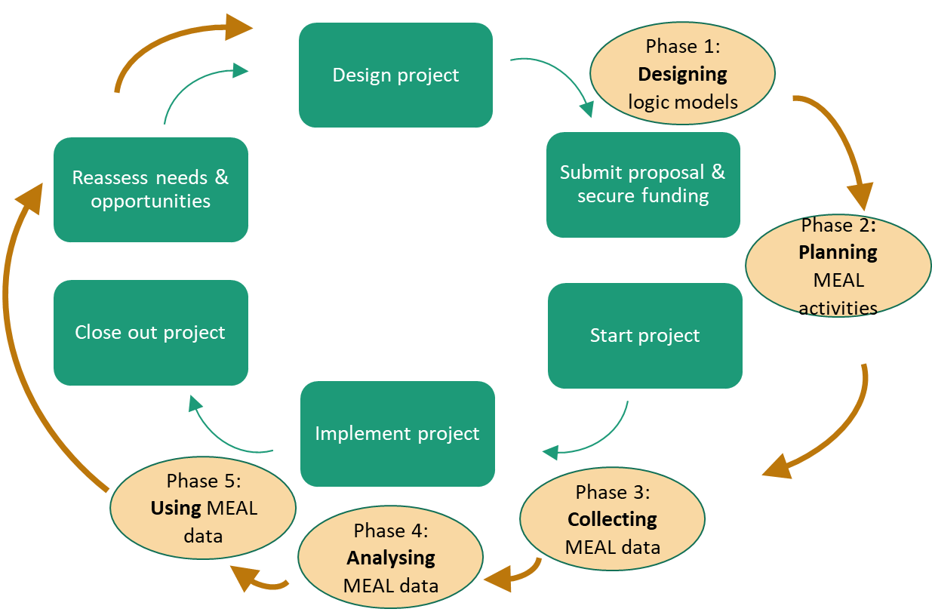
MEAL is critically linked to the project cycle

Slide 10
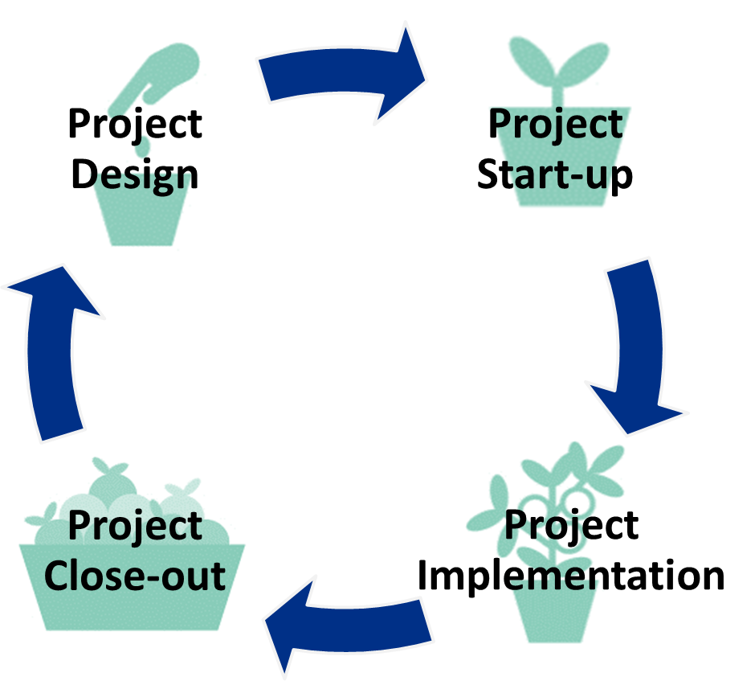
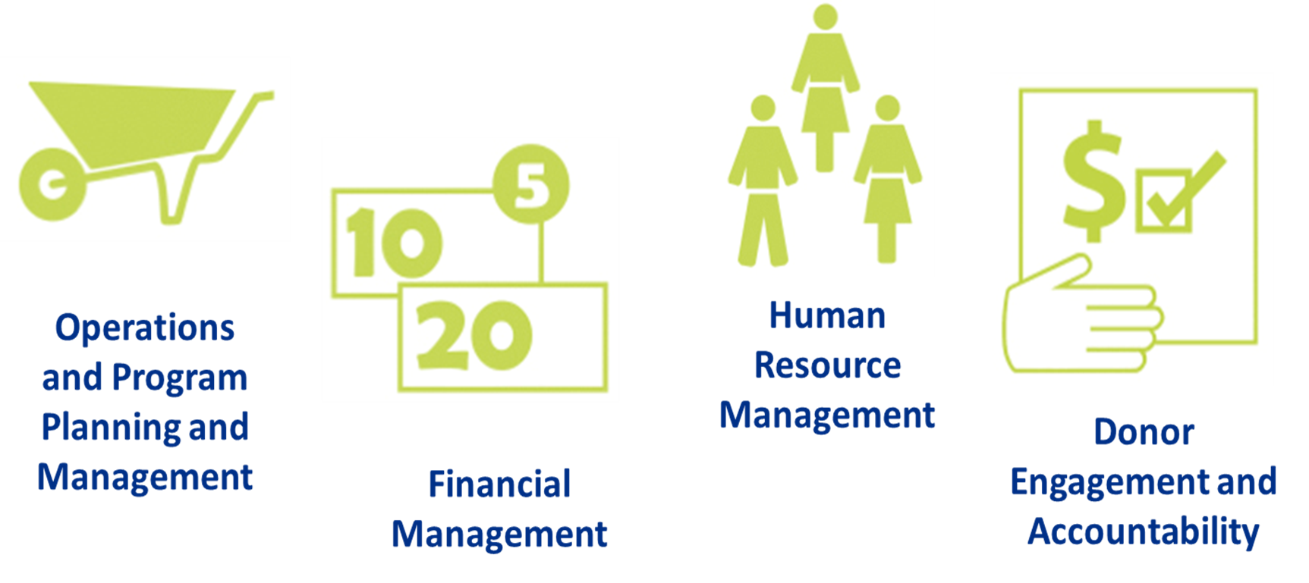
Project Management Cycle
Categories Fundamental to Project Management

Slide 11


Slide 12
Project Design
Problem Statement and Analysis

Slide 13
What is a problem?
Problem Analysis
A specific negative situation related to the human condition.
Problems arise due to varied situations and could be identified using different methods including situational analysis, gap analysis and problem tree analysis.
Basic and useful method to:
Identify the major problems;
Determine cause and effect relationships;
Prioritize what should be addressed through a project’s strategy or intervention.

Slide 14

Effect: Effects are social, environmental, political or economic conditions, usually negative, that result from the problem.
High health care costs
More young people with diabetes
High blood pressure and heart problems
Food induced cancers
Overweight among young people
Cause: A cause is an underlying factor that exists in the household, community, organization or external environment that has brought about the problem.
Insufficient physical exercise
High intake of fats and sugar
Lack of sports facilities
Computer games and internet
High fast-food intake

Slide 15
Solution tree
Improved household economics
Outcome: What we expect to accomplish and contribute to population level changes
Reduced high health care costs
Reduced diabetes cases among young peopled
Reduced high blood pressure and heart problems
Reduced food induced cancers
Opportunities: Means of solving a problem or dealing with a difficult situation.
Healthy young people
More young people engaged in physical exercise
Intake of balanced diet
Solution: Means of solving a problem or dealing with a difficult situation.
Establish sports facilities
Mental and physical training and coaching
Nutrition initiatives

Slide 16
Group | Problem | Solution
Amazing persons with disabilities | Limited access to sexual and reproductive health services (SRH), information, and rights Physical, emotional, sexual violence gender-based violence and mental health issues | Capacity building on sexual and reproductive health services (SRH) and rights
Green spaces | Unclean and unhealthy living environment in Mombasa County | Planting mangrove trees Awareness creation and clean-up exercises
Ololoo youth hub initiative | Youths with history of drug abuse, crimes and gang violence in the community | Counselling of youths with a history of drugs, crimes and gang violence Capacity building on entrepreneurship, financial literacy, and life skills
Bahari Community Empowerment center | Increased teenage pregnancies in Kisauni | Awareness campaigns on negative impacts of teenage pregnancies Capacity-building on learning and economic empowerment opportunities
Kadzandani Creative Youth Organization | Rise in gender-based violence during COVID-19 pandemic | Awareness raising on GBV through tweet chats with expert panel discussions Engaging girls and boys on GBV
Monica Kahenda | Limited access to sanitary towels | Capacity building on reusable towels, information access, menstrual products, services and facilities

Slide 17
Project Design
Theory of Change (TOC)

Slide 18
Theory of Change (TOC)
A ToC describes a process of desired change by making our assumptions explicit about a current problem, its underlying causes, the long-term change we seek, and what needs to happen in order for that change to occur.
Makes clear how and why you expect or assume that certain actions will produce desired changes (for individuals, groups, communities or institutions) in the environment where the project will be implemented.
Expressed as:
“If we do X (action),
then we will produce Y (change),
because Z (how and why assumptions).”

Slide 19
TOC Example
IF | SO1 SO2 | Assumption | THEN | Project Goal | BECAUSE | Evidence base for this theory of change
IF | Returnee families earn income | Returnee families live in adequate and appropriate housing (To be delivered by other actors, used as project targeting criterion) The government has a supportive legal framework | THEN | Returnees are socially and economically integrated into their resident communities | BECAUSE | Results and lessons learned from 20 years of CRS social housing experience have shown these are the most significant factors in successful return.
 | Returnees use public and social services in their communities | The government has a supportive legal framework

Slide 20
TOC for GOYN
IF | Outcomes | Assumption | THEN | Project Goal | BECAUSE | Evidence base for this theory of change
IF | Youth have access to diversified and quality work | AND the government has a supportive legal framework Partners have necessary systems to implement interventions | THEN | Youth in Mombasa will have increased access to opportunities, employability and freedom of expression | BECAUSE
 | Collaborative infrastructure is enhanced to include collaborative building and youth voice, trust and feedback loops in the system
 | There are systemic shifts including policy, engagement and improved social indicators | The government has a supportive legal framework

Slide 21
Changemakers TOCs
No. | Group projects | Theory of Change
1. | Amazing PWDs | IF PWDs are trained on sexual and reproductive health and rights AND the society acts to address their sexuality and reproductive concerns THEN physical, emotional, sexual violence, gender-based violence and mental health issues will be reduced and PWDs will live dignified lives.
2. | Green spaces | IF inhabitants of Moroto have increased awareness on appropriate waste management and importance of mangrove trees AND have improved environmental management practices THEN Mombasa County will have a clean and healthy living environment.
3. | Ololoo youth hub initiative | IF youths with history of drugs, crime and gang violence are counselled and have improved capacities on entrepreneurship, financial literacy and life skills AND they utilize the new skills THEN they will be easily re-integrated into the society resulting in peaceful co-existence amongst the people of Likoni.

Slide 22
Changemakers TOCs Cont’s
No. | Group projects | Theory of Change
4. | Bahari Community Empowerment center | IF youth have increased knowledge on the effects of teenage pregnancies and access to learning and economic empowerment opportunities AND they utilize the opportunities THEN incidences of teenage pregnancies will be reduced in Kisauni Sub County and its environs
5. | Kadzandani Creative Youth Organization | IF the community has increased awareness on GBV AND duty bearers, girls and boys are involved in GBV prevention and response THEN there will be reduced GBV cases in Mombasa County.
6. | Monica and team from Changamwe | IF girls have access to and gain knowledge on reusable sanitary towels AND they have improved menstrual hygiene practices THEN there will be improved sanitation, hygiene and dignity amongst girls in Changamwe Sub County.

Slide 23


Slide 24
Project Design
Results Framework (RF)

Slide 25
Results Framework (RF)
Logic model that provides a visual representation of the identified need (s) and the changes you want to see happen through the project.
Organizes the expected results of a project into a series of “if-then” relationships.
Has the following components:
Goal
Strategic objective
Intermediate results (IRs)/ Outcomes
Outputs
Activities
Notes:
Goal - longer-term, wider development to which the project contributes e.g., states of sustainability, livelihood, well-being, etc.
Strategic Objectives (SOs) express the central purpose of the project. significant benefits that are anticipated by the end of the project
Intermediate Results (IRs): Express the expected change(s) in behaviors, systems, policies or institutions as a result of project outputs and activities.
Outputs: Statements that specify the deliverables resulting from project activities e.g., products, goods, services, knowledge, skills and attitudes.

Slide 26
Goal: Highest level desired end results or impacts to which project contributes
Strategic Objective: How to achieve the goal
Outcomes or Intermediate results: What the project expects to accomplish at the beneficiary level and contribute to population level changes
Outputs: Tangible deliverables resulting from project activities
Activities: Actions undertaken

Slide 27
RF Example 1
Goal: Vulnerable children in the Coastal region of Kenya live with dignity
Strategic Objective: Reduction in child abuse
Outcome or Intermediate result: Community members have increased utilization of child protection services
Output: Community members have increased awareness on and access to child protection services
Activity: Sensitize communities on child abuse and child protection services

Slide 28
Menstrual Hygiene Project – Monica and Team from Changamwe
Goal |  | Improved health and dignity amongst girls in Changamwe Sub County
Objective |  | Improved menstrual hygiene management amongst girls
Outcomes /IRs |  | Increased production of reusable sanitary towels |  | Girls appropriately use and dispose reusable sanitary towels
Output |  | Increased knowledge on production of reusable sanitary towels |  | Increased access to reusable sanitary towels |  | Increased awareness on menstrual hygiene among girls | Increased awareness on menstrual hygiene among girls | 1.3. Increased awareness on mentrual hygiene among girls in Changamwe community
Activities |  | Train ToTs on production of reusable sanitary towels |  | Distribute reusable sanitary towels |  | Conduct awareness campaign on menstrual hygiene | Awareness campaign on menstrual hygiene | 1.3.1 Awareness campaign on menstrual hygiene

Slide 29
Environment project - Green Spaces
Goal |  | Improved health among inhabitants of Mombasa County
Objective |  | Clean and healthy living environment in Moroto slums
Outcomes /IRs |  | Improved waste management practices |  |  |  | Increased planting of mangrove trees
Output |  | Increased awareness on waste management |  | Increased opportunities to participate in clean up exercises |  | Increased awareness on importance of mangrove trees | Increased awareness on menstrual hygiene among girls | 1.3. Increased awareness on mentrual hygiene among girls in Changamwe community
Activities |  | Conduct awareness creation on waste management |  | Conduct clean up exercises |  | Conduct sensitization on importance of mangrove trees | Awareness campaign on menstrual hygiene | 1.3.1 Awareness campaign on menstrual hygiene

Slide 30
Project Design
Logical Framework/ Logframe/ Proframe

Slide 31
What is a Logical Framework?
Visual representation of the project that describes its key features and the specific logical linkages between them.
Intended to communicate the purpose and main components of a project as clearly and simply as possible.
Has the following components:
  Objective statements
  Performance indicator statements
  Measurement methods/ Data sources
  Critical assumptions- Factors or conditions outside of the project design team’s control yet the existence of which is critical to allowing the project to achieve its next-highest-level objective e.g., natural hazards, political stability, security situation, disease outbreaks.

Slide 32
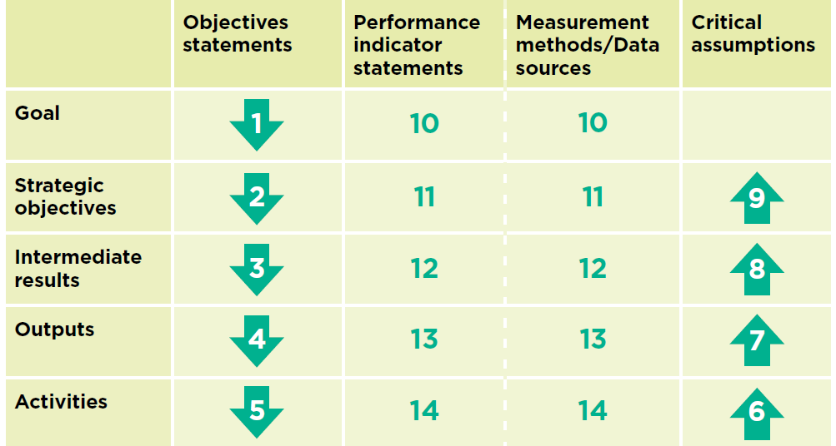
LogFrame Template
(Then)
(Then, IF)
(Then, IF)
(Then, IF)
(IF)

Slide 33
Menstrual Hygiene Project – Monica and Team Changamwe
 | Objectives Statements | Performance Indicators | Means of verification/ Data sources | Risks/ Critical Assumptions
Goal | Improved health and dignity amongst girls in Changamwe Sub County | Reduced number of menstrual hygiene related illnesses | Health facility records | Materials for production of reusable towels will be available Insecurity incidences do not hinder project activities
Objective | Improved menstrual hygiene management amongst girls | % of girls reporting improved hygiene practices as a result of information access, reusable sanitary towels | Survey report
Outcome/ IR | Increased production of reusable sanitary towels | Number of reusable sanitary towels produced | Stock and supply documents
 | Girls appropriately use and dispose reusable sanitary towels | Number of girls who demonstrate appropriate use and disposal of reusable sanitary towels | Survey report
Output | Increased knowledge on production of reusable sanitary towels | Number of girls with increased knowledge on making reusable sanitary towels | Training report/ Participants list
 | Increased access to reusable sanitary towels | Number of girls accessing reusable sanitary towels | Activity reports/ Distribution list
 | Increased awareness on menstrual hygiene among girls | Number of people reached with key menstrual hygiene messages | Activity report
Activities | Train Trainer of Trainees (TOTs) on production of reusable sanitary towels | Number of TOTs trained on production of reusable sanitary towels | Training report/ Participants list
 | Distribute reusable sanitary towels | Number sanitary towels distributed Number of girls receiving reusable sanitary towels | Activity reports/ Distribution list
 | Conduct awareness campaigns on menstrual hygiene | Number of awareness campaigns on menstrual hygiene conducted | Activity report

Slide 34
Environment Project – Green Spaces
 | Objective Statements | Performance Indicators | Means of verification/ Data sources | Risks/ Critical Assumptions
Goal | Improved health among inhabitants of Moroto slums in Mombasa County | Reduced number of hygiene related illnesses | Health facility records | Insecurity incidences do not hinder project activities
Objective | Clean and healthy living environment in Mombasa County
Outcomes/ IRs | Improved waste management practices | Number of people demonstrating appropriate waste management practices | Survey report
 | Increased planting of mangrove trees | Number of mangrove trees planted | Activity report
Outputs | Increased awareness on importance of mangrove trees | Number of people reached with key messages on important of mangrove trees | Activity report
 | Increased opportunities to participate in clean up exercises | Number of people participating in clean up exercises | Activity report
 | Increased awareness on waste management | Number of people reached with key messages on waste management | Activity report
Activities | Conduct sensitization on importance of mangrove trees | Number of sensitization meetings/forums held on importance of mangrove trees | Activity report, Radio spot checks
 | Conduct clean up exercises | Number of clean up exercises conducted | Activity report
 | Conduct awareness creation on waste management | Number of awareness creation meetings/forums/campaigns held on waste management | Activity report, Radio spot checks
Notes:
Data sources
Before collecting data. Ask and explain: Why information is being collected? How were participants were identified? How the data will be collected? How much time the data collection will take? What questions do you need to have in the tools? What language and clarity of questions to use?
After collecting data. Ask and explain: How the data will be used? Who will have access to the data?

Slide 35


Slide 36
Reporting
Notes:
Post the following three questions: 1) Who can tell us what a report is? 2) What comprises of a report? 3) Why do we need reports?

Slide 37

What is a report?
Document that presents information in an organized format for a specific audience and purpose.
Accounts for actions taken by the organization through writing in a document that meets requirements either by donor or an adopted format.
Why reports?
Tell your story and share successes – Achievement and Impact.
Record what is working, what is not, and why
Provide transparency and accountability to stakeholders
Facilitate learning and dialogue among stakeholders
Create institutional memory
Promote a better understanding of the project among stakeholders
Help document and manage financial aspects of the project
Notes:
A progress report with the purpose to keep readers informed, only the latest information is needed. If you want to present the project to a potential donor, or you want to inform other outsiders, you need to be more elaborate in explaining where the project is all about. The target group will also determine the level of language you need to use.

Slide 38
Preparation for report writing
1. What information is needed? Decide which kind of information needs to be in the report. For donors, four types of information are usually needed:-
Results (impact)
Implemented activities in accordance with project proposal/ work plan
How was the money spent? (finance/budget information)
Information about the organization and project staff.
2. Why the progress report? Is it to inform others so that they become interested in the project? Or is it a presentation of the results of the project to e.g., your donor?
3. What is the format? Check whether the report needs to be written in a compulsory layout (e.g., headings footings, standardized form/ template, etc.)
4. Who are your audience? The contents need to be adjusted to the people who will read it, e.g. How much information do they already have about the project?
Notes:
Prepare for report writing in advance
Gather the necessary information ahead of time from your colleagues
Background section in the progress report format will not change from report to report, so keep this on file.

Slide 39
Preparing for report writing
5. What structure is there? Check how the contents of the report need to be arranged.
6. How long should the report be? Determine the maximum number of pages in consultation with whoever commissioned the report.
7. How often (Time span)? Check out when the report needs to be ready. Then make a time plan for writing the report (date for completing the first draft, date for having it checked by a senior colleague etc.).

Slide 40
GOYN Report template
Program Name | Global Opportunities Youth Network
Location (city, Country) | Mombasa
Date | 27th August 2021
Youth innovator name (project name) | Gender based Violence Project by Kadzandani Creative Youth Organization
Project progress report | Activities implemented
Accomplishments | Outputs/Outcomes: What has been achieved as a result of the activities Opportunities to build on success Plans for the Next Reporting Period
Challenges | What were the constraints and possible solutions
Please include 3 photos from the project.
Notes:
Background section in the progress report format will not change from report to report, so keep this on file.
Don’t forget to use photos, if possible, charts, tables, maps,, etc. to break up narrative and make the report more readable and succinct.

Slide 41
Photography
What do we know about taking a good photo?
What do we need to take a good photo?
What opportunities are there for us to take photos within our project?
Notes:
Amazing persons with disabilities, Green spaces, Ololoo youth hub initiative, Bahari Community Empowerment center, Kadzandani Creative Youth Organization, Monica Kahenda

Slide 42

Telling stories with photos
Tips for interesting photos
Vary angles
Take different frames - horizontal and vertical
Take more than one photo considering context, angle and frame
Ask yourself
Why am I taking this photo?
What is my message?
What do I want the viewer to understand/ feel?
When taking a photo consider
Details
Portraits
Scenes
Notes:
Always take a consent before taking photos of beneficiaries.
Individual or group. You can arrange groups to make a story. Scenes tell stories about people in their environment

Slide 43
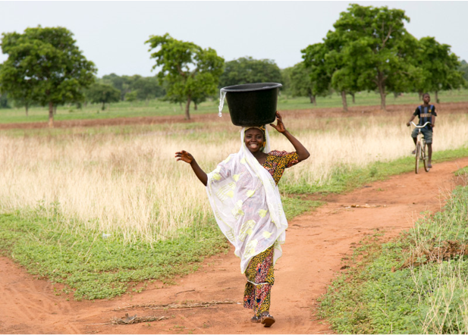
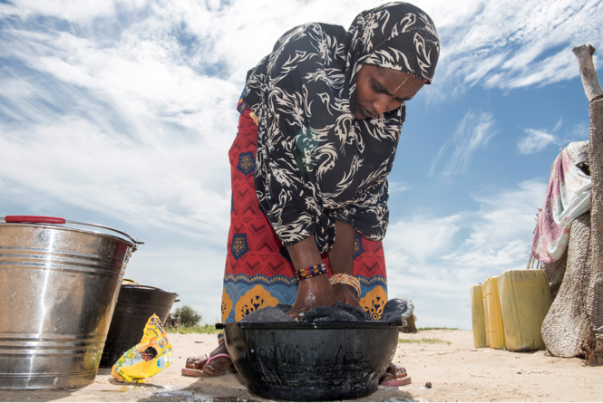
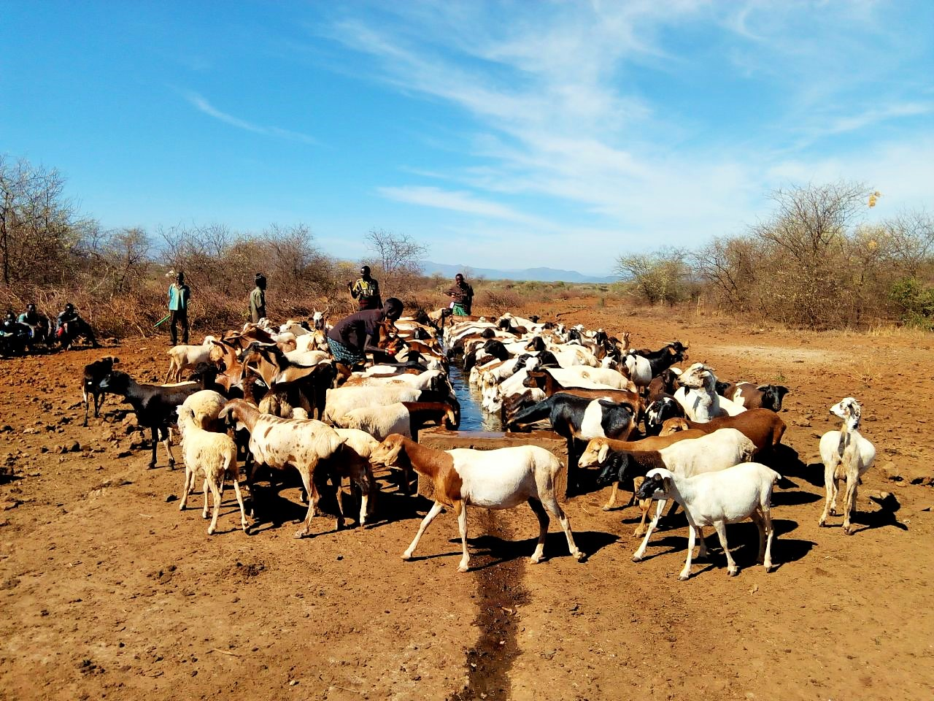
Photography
1. Light
Ensures clarity.
Bad light causes loss of details.
Shoot during sunrise and before sunset
Take advantage of cloud cover
Use flash even during daylight
2. Background
Sky makes a good background. Others- wall, curtain hangings etc.
Background should not have much distraction
3. Moment
Look for human emotion or interaction
Talking photo
Notes:
Caption #1 reads: “Name, a female champion against GBV heading home from her farm”
Caption #2 reads: “Fatuma (not her real name), a beneficiary of x water project washing her cloths”
Caption #3 reads: “Livestock in x grazing area accessing drinking water from a livestock trough supported by

Slide 44


Slide 45
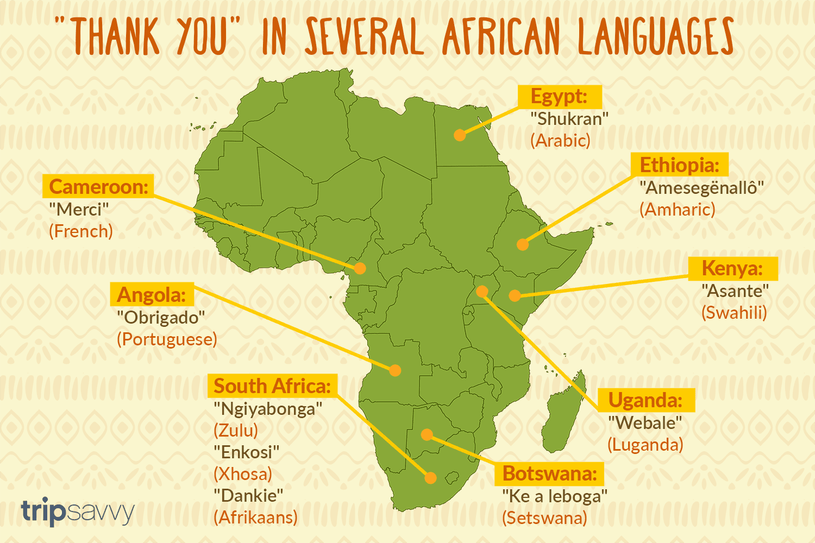

Slide 46

End of GOYN MEAL Workshop

Slide 47
Thank you

