Slide 1
YOUTH ADVISORY GROUP (YAG) JOINT SESSION
30 June 2021
Welcome! Please type your name and community in the chat box. Please select your preferred language by clicking on the globe icon or on “Interpretation” at the bottom of your screen.
¡Bienvenidos! Escriba su nombre y comunidad en el cuadro de chat. Por favor, seleccione su idioma preferido haciendo clic en el icono del globo o en "Interpretación" en la parte inferior de la pantalla.
Bem-vindo! Digite seu nome e comunidade na caixa de bate-papo. Selecione seu idioma preferido clicando no ícone do balão ou "Interpretação" na parte inferior do pantalla.
स्वागत हे! कृपया चैट बॉक्स में अपना नाम और समुदाय लिखें। कृपया ग्लोब आइकन पर या अपनी स्क्रीन के नीचे "व्याख्या" पर क्लिक करके अपनी पसंदीदा भाषा का चयन करें।

Slide 2
YOUTH ADVISORY GROUP (YAG) JOINT SESSION
30 June 2021
Meeting recording and transcripts can be vieewed and downloaded at :
https://youthbuild-org.zoom.us/rec/share/sR59mccNoBnZI8ZJMINdpjBUvi4NmkqKl0RjuPwFcgGn-w4vXj2I6_7zgXlhJHUR.jHXCWmPO_-N4yF4C

Slide 3
Agenda:
Welcome
YAG Training:
Understanding Qualitative and Quantitave Data
Community group discussions
Review 2020 Structural Injustice focus group conversations
Group discussion:
What do we want to learn?
Who can we engage in focus groups?
Reflect on learnings from training
Agree on next steps
Adjourn
कार्यसूची:
स्वागत है
याग प्रशिक्षण:
गुणात्मक और क्वांटिटेव डेटा को समझना
सामुदायिक समूह चर्चाएं
समीक्षा २०२० संरचनात्मक अन्याय फोकस समूह बातचीत
समूह चर्चा:
हम क्या सीखना चाहते हैं?
हम फोकस समूहों में कौन शामिल हो सकता है?
प्रशिक्षण से सीखने पर प्रतिबिंबित
अगले कदमों पर सहमत
स्थगित करना
Agenda:
Bienvenida
2. Capacitación de YAG:
Que son los datos cualitativos y cuantitativos
Discusiones en grupos comunitarios
Revisar las conversaciones de los grupos focales de injusticia estructural 2020
Discusión en grupo:
¿Qué queremos aprender?
¿A quién invitamos a participar en grupos focales?
Reflexiones sobre los aprendizajes de la capacitación
Acordar los próximos pasos
Aplazar
Agenda:
Bem-vindo
Treinamento YAG:
Quais são dados qualitativos e quantitativos
Discussões em grupos comunitários
Reveja as conversas do grupo focal de injustiça estrutural de 2020
Discussão em grupo:
O que queremos aprender?
Quem convidamos para participar de grupos focais?
Reflexões sobre aprendizados
Concordo com os próximos passos
Adiar

Slide 4
What is research?
Understanding data collection tools and their application in structural injustice conversations.
Laura Kim , DevLEarn
30 June 2021

Slide 5

My objectives today are…
To get you excited about research (if you’re not already excited)
To talk about what makes research… research.
To talk about why research is important when it comes to understanding structural injustice.

Slide 6

So… what is research?
Entonces…¿Qué es la investigación?
Choose your answer:
The study of materials and sources to establish facts and reach new conclusions.
A process that entails collection of data; documentation of important information; and analysis and interpretation of that data and information.
A creative, systematic activity done to increase our knowledge, including our knowledge of people, culture, and society, and the use of this knowledge to develop innovations.
A process of steps used to collect and analyze information to increase our understanding of a topic or issue. It consists of three steps: pose a question, collect data to answer the question, and present an answer to the question.
Elija su respuesta:
El estudio de materiales y fuentes para establecer hechos y llegar a nuevas conclusiones.
Un proceso que implica la recopilación de datos; documentación de información importante; y el análisis y la interpretación de esos datos e información.
Una actividad creativa y sistemática realizada para aumentar nuestro conocimiento, incluyendo nuestro conocimiento de las personas, la cultura y la sociedad, y el uso de este conocimiento para desarrollar innovaciones.
Un proceso de pasos utilizados para recopilar y analizar información para aumentar nuestra comprensión de un tema o problema. Consta de tres pasos: plantear una pregunta, recopilar datos para responder a la pregunta y presentar una respuesta a la pregunta.
Então, o que é pesquisa?
इसलिए।।। अनुसंधान क्या है?
Escolha sua resposta:
O estudo de materiais e fontes para estabelecer fatos e chegar a novas conclusões.
Um processo que envolve a coleta de dados; documentação de informações importantes; e a análise e interpretação de tais dados e informações.
Uma atividade criativa e sistemática realizada para aumentar nosso conhecimento, incluindo nosso conhecimento sobre pessoas, cultura e sociedade, e o uso desse conhecimento para desenvolver inovações.
Um processo de etapas utilizadas para coletar e analisar informações para aumentar nossa compreensão de um problema ou problema. Consiste em três passos: fazer uma pergunta, coletar dados para responder à pergunta e enviar uma resposta à pergunta.
अपना जवाब चुनें:
तथ्यों को स्थापित करने और नए निष्कर्ष तक पहुंचने के लिए सामग्री और स्रोतों का अध्ययन।
एक प्रक्रिया जिसमें डेटा के संग्रह पर जोर दिया जाता है; महत्वपूर्ण जानकारी का दस्तावेजीकरण; और विश्लेषण और उस डेटा और जानकारी की व्याख्या ।
हमारे ज्ञान को बढ़ाने के लिए किया गया एक रचनात्मक, व्यवस्थित गतिविधि, जिसमें लोगों, संस्कृति और समाज के बारे में हमारा ज्ञान और नवाचारों को विकसित करने के लिए इस ज्ञान का उपयोग शामिल है।
किसी विषय या मुद्दे की हमारी समझ बढ़ाने के लिए जानकारी एकत्र करने और विश्लेषण करने के लिए उपयोग किए जाने वाले चरणों की एक प्रक्रिया। इसमें तीन चरण होते हैं: एक प्रश्न प्रस्तुत करें, प्रश्न का उत्तर देने के लिए डेटा एकत्र करें, और प्रश्न का उत्तर प्रस्तुत करें।

Slide 7
There are many types of research
Within GOYN, you may have heard a lot of terms like…
Monitoring
Evaluation
Assessment, Self-Assessment
Results
Outputs, outcomes
Outcome harvesting, randomized controlled trials, etc.
These terms are used to make sure that GOYN’s research is 1) focused on understanding the lives of OY and 2) focused on measuring whether GOYN’s activities are achieving their intended impact.
You will get a chance to learn about these different terms in September 2021 at the Youth Innovation and Learning Gathering

Slide 8
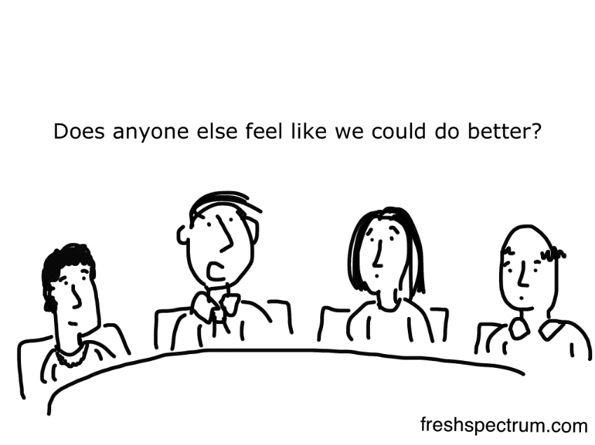
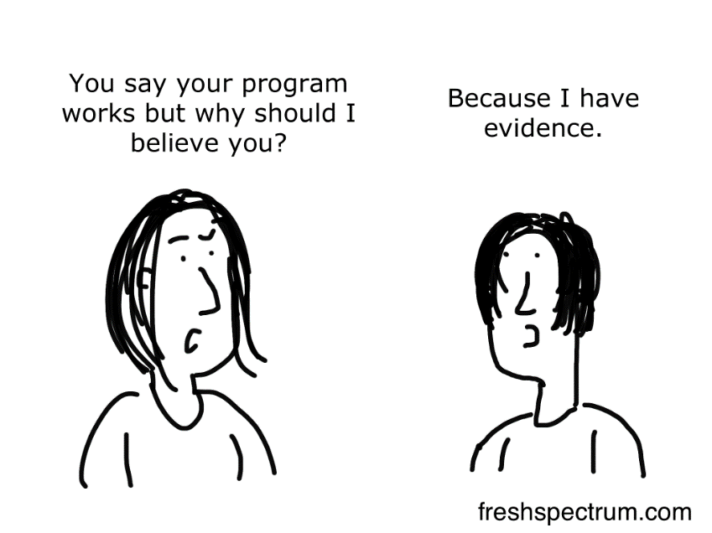
Different types of research serve different purposes.
Within GOYN, research is used to:
Better understand the lives of OY and the barriers they face
Understand the employment system that OY must navigate
Measure whether GOYN’s activities are achieving their intended impact.
Learn, adapt, and improve!

Slide 9

For every type of research you conduct, there are three main methods to choose from:
Quantitative method
Qualitative method
Mixed methods

Slide 10
Quantitative research method
Why do we use the quantitative research method?
To observe situations and events through mathematical/numerical means
To study a large group of people
What makes quantitative research quantitative?
The information you collect is analyzed in numerical form (e.g. counts, frequencies, percentages, etc.) The information itself can be non-numeric, but it needs to be measured using numbers.

Slide 11
Quantitative research method
Example A. Which community do you represent?
GOYN Bogotá
GOYN Mombasa
GOYN Pune
GOYN Ramgarh
GOYN São Paulo
GOYN eThekwini
GOYN Mexico City
Example B. Who is your favorite superhero?
Spiderman
Wonder Woman
Batman
Iron Man
Superman
Black Panther
Wanda Maximoff/Scarlet Witch
Captain America
Notes:
Add teaser questions

Slide 12
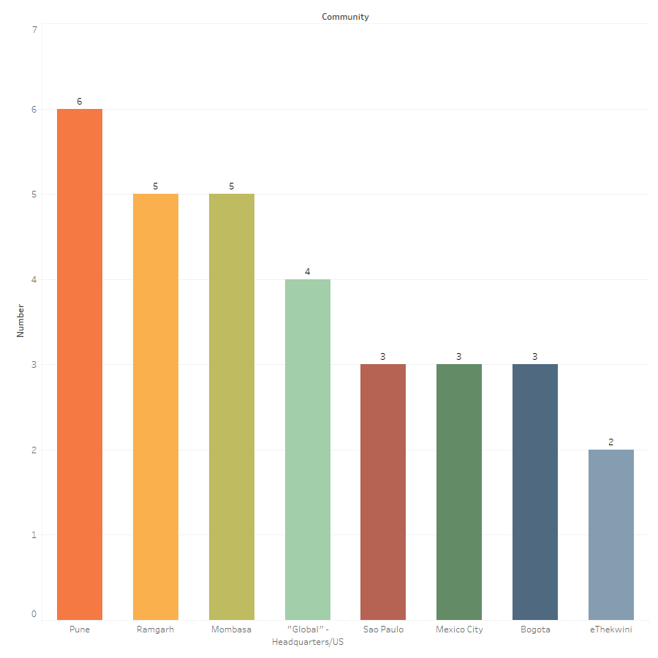
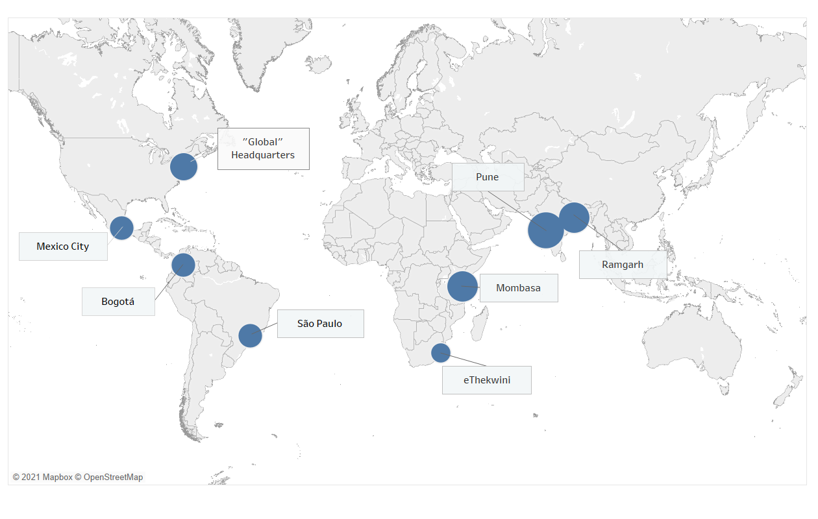
8 communities were represented, with a total of 31 respondents. Pune had the highest number of respondents.

Slide 13

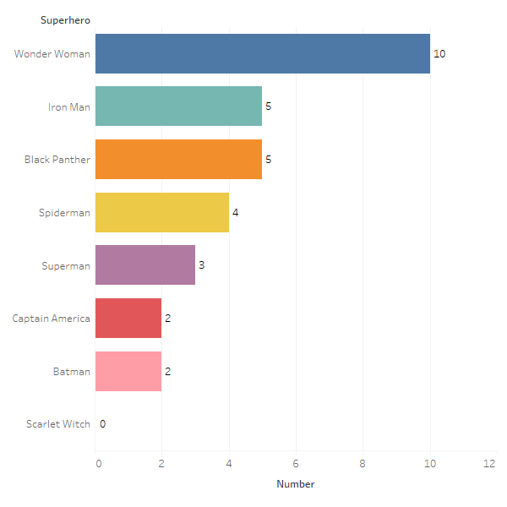
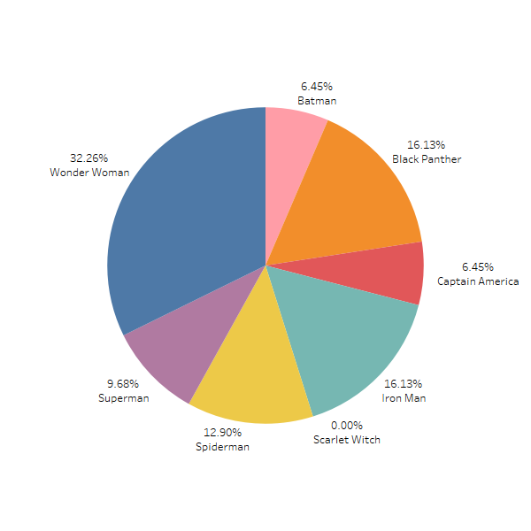

Wonder Woman was the favorite superhero among all the options provided.

Slide 14
Quantitative research method
Example A: What is your gender identity?
Female (cisgender)
Male (cisgender)
Gender non-binary
Female (transgender)
Male (transgender)
Example B: How satisfied are you with current employment opportunities in your community?
Very satisfied
Satisfied
Neither satisfied nor dissatisfied
Dissatisfied
Very dissatisfied
A common tool to collect data for quantitative research is a survey questionnaire.
Notes:
Add teaser questions

Slide 15
Making sure quantitative research is good quality.
For quantitative research to be effective:
Your survey questions must be carefully designed because the answers are pre-determined.
While you cannot survey everybody, you still need to be able to survey a high number of people (sample) to make sure that your results reflect the people you are studying.
Limitations of quantitative research:
Survey questions are limiting because answers are predetermined by the researcher.
Information cannot always be numerical.
It does not always allow for the researcher to probe for details.

Slide 16
Qualitative research method
Why do we use the qualitative research method?
To understand people’s lived experiences (through select people)
To understand context by understanding how culture, history, economy, politics, religions affect people’s lives and their opinions and perceptions
What makes qualitative research qualitative?
The information you collect is what people say about their feelings, opinions, experiences, and knowledge. It can also be your observations about people’s behaviors and actions. It can also be written material and documents, like letters, publications, photographs, videos, etc

Slide 17
Qualitative research method
Common tools to conduct qualitative research:
Observations → detailed notes that the respondent takes about the setting and people’s activities and behaviors.
Interviews → these occur on a one-to-one basis where a researcher tries to understand the respondent’s perspective.
Focus group discussions (FGDs) → these are group discussions that are being nurtured by a facilitator. Participants get to hear each other’s responses and make additional comments beyond their own original ones. These interactions can enhance data quality through gathering diverse perspectives and facilitating consensus.
How satisfied are you with the current employment opportunities in your community?
How satisfied do you think youth are with current employment opportunities in your community?

Slide 18
Qualitative research skills
Principles | Illustrative Example
1. Ask open-ended questions. | What is a strong memory you have of your job? (Not: Do you have any strong memories of your job?)
2. Be clear. | What was most important to you about your experience? (Not: What was important thing that you’ll remember and can tell people about it now that you think about it?)
3. Listen. | That is very helpful. I think you explained very well.
4. Probe as appropriate. | Could you help me understand a bit better? Tell me more about what happened and how you were involved.
5. Observe. | I can see that my question evoked strong emotions. Take your time, or if you’d like, we can change topics for the moment and return to this later.
6. Be both empathic and neutral. | I appreciate your willingness to share your story. Every story is unique and we’ve heard all kinds of things. There’s no right or wrong answer to any of these questions. What matters is that it’s your story.
7. Make transitions. | You’ve been describing how you got your job. Now the next set of questions is about what you experienced at your job.
8. Distinguish types of questions. | Descriptive behavior question: What do you do at your job? Interpretive opinion question: What do you like or don’t like about your job?
9. Be prepared for the unexpected. | Despite a commitment to a 2-hour interview, only a half-hour may be available. Make the most of it.
10. Be present throughout. | Checking your time, glancing at your phone, looking around – these things are noticed by the respondent.
Source: Adapted from Patton, M.Q. (2015) Qualitative Research and Evaluation Methods: Integrating Theory and Practice

Slide 19
Analyzing qualitative research
In qualitative research, you analyze themes to determine whether there is a pattern.
Inductive analysis: searching data for themes/patterns without any preconceived analytical categories
Deductive analysis: searching data for themes/patterns with preconceived analytical categories

Slide 20
Making sure qualitative research is good quality.
For qualitative research to be effective:
You, as the researcher, must bring solid skills and experience to conduct interviews and to facilitate FGDs.
Limitations of qualitative research include:
Difficulty in generalizing findings because your respondents do not represent the population you are studying.
Time-intensive to conduct.
Inherently prone to bias since no two researchers will conduct the data collection the same way.

Slide 21
Mixed methods research
Why do we conduct mixed methods research?
Mixed methods involves the combination of qualitative and quantitative methods.
Integration can help overcome limitations in just using one method
Provides greater breadth of knowledge and perspective
Can help a wider range of audiences connect to the material

Slide 22
Mixed methods research
In sequential mixed methods design, the researcher seeks to elaborate on or enrich the findings of one method with another method. Data collection hand analysis happens in two phases.
Sequential Explanatory Design
Sequential Exploratory Design
QUANT data coll.
QUANT analysis
QUAL data coll.
QUAL analysis
FINDINGS
QUAL data coll.
QUAL analysis
QUANT data coll.
QUANT analysis
FINDINGS

Slide 23
Mixed methods research
In concurrent mixed methods designs, the researcher converges or merges quantitative and qualitative data in order to provide a comprehensive analysis.
Concurrent Triangulation Design
Concurrent Nested Design
OR
QUAL data coll.
QUAL analysis
Comparative analysis
FINDINGS
QUANT data coll.
QUANT analysis
QUAL data coll.
Analysis
FINDINGS
QUANT data coll.
QUANT data coll.
QUAL data coll.
Analysis
FINDINGS

Slide 24
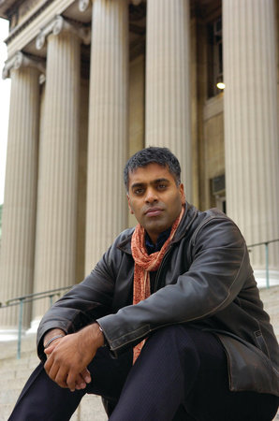
Dr. Sudhir Venkatesh
He’s a professor of sociology at Columbia University in New York City.
He is currently one of the most respected sociologists in the United States.
But he was once a young person, too.
In 1989, he was a student at the University of Chicago in Chicago, Illinois.

Slide 25
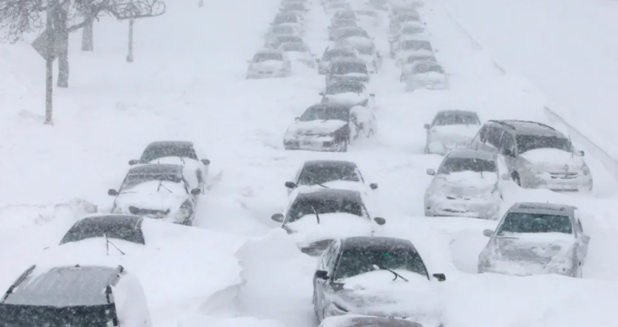

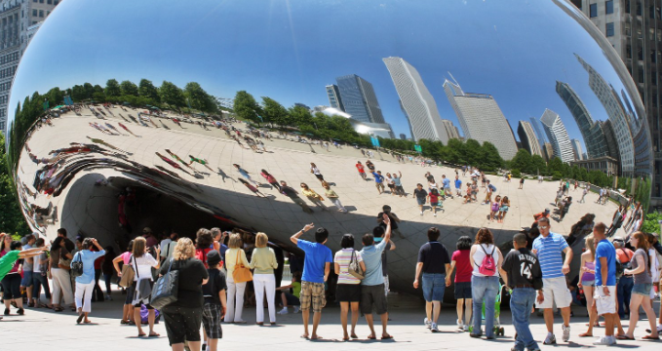
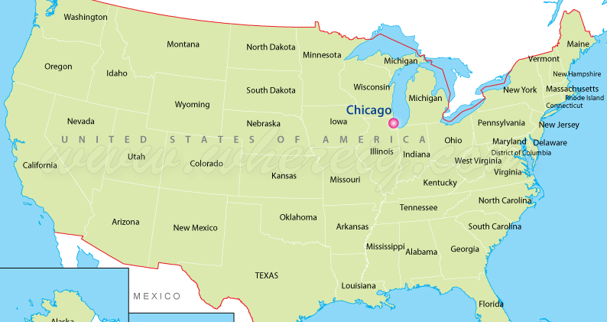


Chicago, Illinois, United States

Slide 26
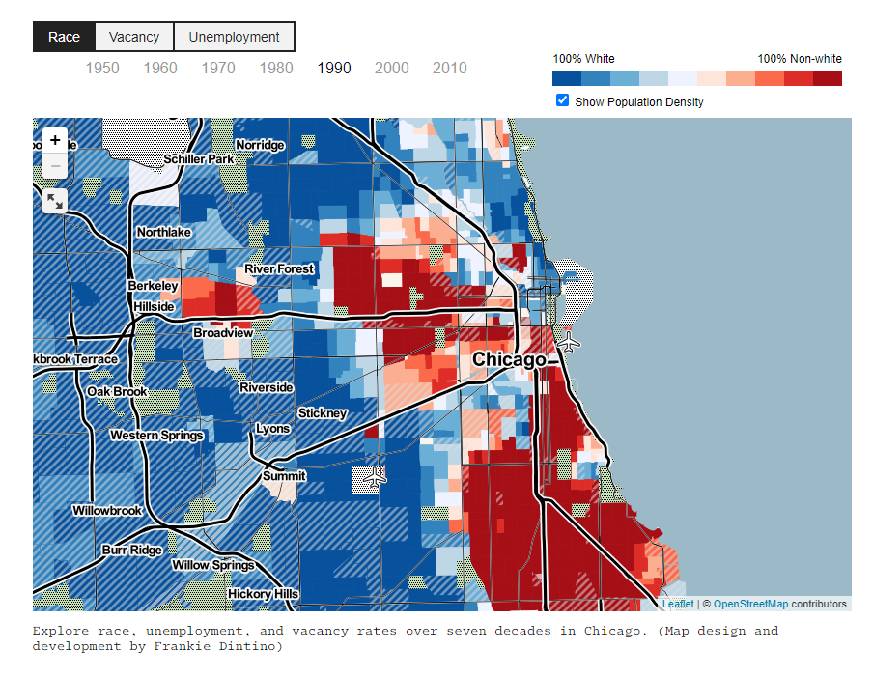
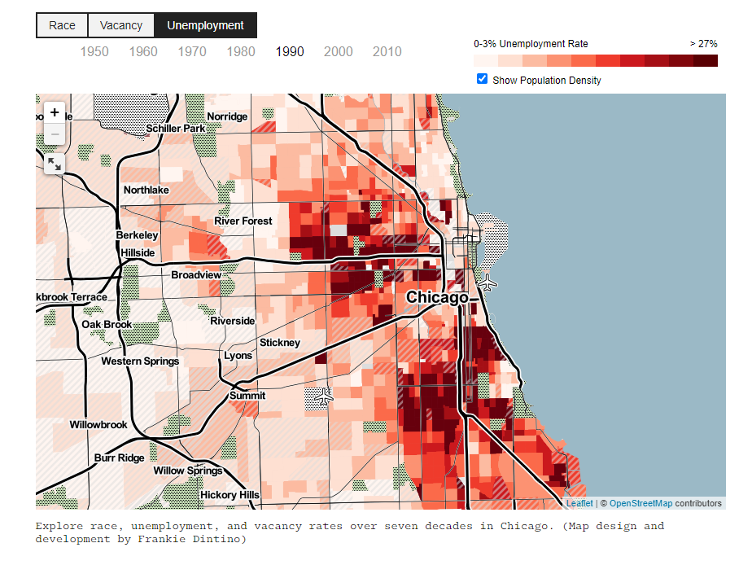
Chicago, Illinois, United States (1990)
Legacy of structural injustice
Considered to be the most segregated city in the United States

Slide 27


As a student of sociology, Sudhir was helping a professor with a research study designed to understand urban poverty as experienced by different populations.
Sudhir was tasked with going to a public housing area called the Robert Taylor Homes in the South Side of Chicago to gather information using a survey questionnaire to understand the lives of black young people living there.
Use your imagination

Slide 28
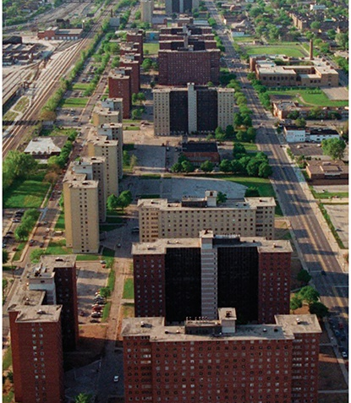
Robert Taylor Homes
Built in the 1960s, the Robert Taylor Homes were once the largest and most infamous public housing projects (sites) in America.
The site had 28 buildings, around 16 floors each, made of concrete and steel, stretching for 2 miles (3.2 km).
It was planned for 11,000 people, but there were close to 30,000 people living there, 96% African American, 95% unemployed.
It was known to be overcrowded, underfunded, and run by rival gangs who were involved in the drug trade (crack-cocaine).

Slide 29
Question 1. How does it feel to be black and poor in America?
1. Really bad
2. Bad
3. OK
4. Good
5. Very good
F**k you

Slide 30
“You know what? You really need to live with people. You can’t ask them silly questions and hope you’re going to get the real answers about life around here.
If you’re going to try and understand, you’re going to have to come back and hang out with us.”
- Gang leader, “J.T.”

Slide 31

7-year relationship with the Black Kings, a 200-group street gang in the Robert Taylor Homes
Sudhir was able to obtain the trust of “J.T.” who gave him access to the community living in these homes.
Sudhir conducted qualitative research in the form of participant-observation and interviews to get an understanding of what life was like for these youth. He was also able to look at the gang’s finances and bookkeeping.
He was also able to conduct quantitative research by administering survey questionnaires with gang members (after revising the questions of course)

Slide 32
What did we learn about young people who live in the Robert Taylor homes?
Despite being an overlooked and underserved group, these youth managed to self-teach strong entrepreneurial and management skills – imagine their potential had they been provided with opportunities.
The gang leader, “J.T.”, had a university degree with a corporate job. But he did not see a future for himself in mainstream US corporate culture, and chose to come back to his community and run the gang. This said a lot about the system in which young black people were living in, and the pessimistic view they had about what they could accomplish.
As violent as the Black Kings were and as illegal as their activities were, they also served their community by (1) protecting them from the police and other gangs, (2) providing them with money, (3) organizing social activities like basketball games, and (4) providing housing for the homeless.

Slide 33
What did we learn about conducting research?
Survey questionnaires need to be designed carefully. Don’t ask disrespectful questions for the purposes of research, even if they seem “scientific.”
Survey questions (quantitative method) are important, but they are not always enough. Qualitative research allows us to get a fuller understanding of the lives of people and their communities.
Conducting research requires establishing trust and rapport with your study group. Who the researcher/data collector is important and how this person conducts themselves is equally important.

Slide 34
What is Structural Injustice?
¿Qué es la injusticia estructural?
Structural injustice is injustice replicated by a system of rules that persistently tries to disempower members of particular social groups. Such groups may be defined by racial or ethnic identity; gender identity; sexual orientation; religious affiliation; physical ability; social class or caste; or other regionally imposed differentiating factors that create barriers to opportunity in all aspect of life and livelihoods.
Jugov, T. and Ypi, L. (2019), Structural Injustice, Epistemic Opacity, and the Responsibilities of the Oppressed. J Soc Philos, 50: 7-27. doi:10.1111/josp.12268
La injusticia estructural es una injusticia replicada por un sistema de reglas que persistentemente trata de desempoderar a los miembros de grupos sociales particulares. Esos grupos pueden definirse por su identidad racial o étnica; identidad de género; orientación sexual; afiliación religiosa; capacidad física; clase social o casta; u otros factores diferenciadores impuestos a nivel regional que crean barreras a las oportunidades en todos los aspectos de la vida y los medios de subsistencia.
Jugov, T. and Ypi, L. (2019), Structural Injustice, Epistemic Opacity, and the Responsibilities of the Oppressed. J Soc Philos, 50: 7-27. doi:10.1111/josp.12268
O que é injustiça estrutural?
संरचनात्मक अन्याय क्या है?
A injustiça estrutural é uma injustiça replicada por um sistema de regras que persistentemente busca descapacitar membros de determinados grupos sociais. Esses grupos podem ser definidos por sua identidade racial ou étnica; identidade de gênero; orientação sexual; afiliação religiosa; capacidade física; classe social ou casta; ou outros fatores diferenciais impostos a nível regional que criam barreiras às oportunidades em todos os aspectos da vida e dos meios de subsistência.
Jugov, T. and Ypi, L. (2019), Structural Injustice, Epistemic Opacity, and the Responsibilities of the Oppressed. J Soc Philos, 50: 7-27. doi:10.1111/josp.12268
संरचनात्मक अन्याय नियमों की एक प्रणाली है कि लगातार विशेष सामाजिक समूहों के सदस्यों को सशक्त बनाने की कोशिश करता है द्वारा दोहराया अन्याय है । ऐसे समूहों को नस्लीय या जातीय पहचान द्वारा परिभाषित किया जा सकता है; लिंग पहचान; यौन अभिविन्यास; धार्मिक संबद्धता; शारीरिक क्षमता; सामाजिक वर्ग या जाति; या अन्य क्षेत्रीय रूप से लगाए गए अंतर कारक जो जीवन और आजीविका के सभी पहलू में अवसर की बाधाएं पैदा करते हैं।
Jugov, T. and Ypi, L. (2019), Structural Injustice, Epistemic Opacity, and the Responsibilities of the Oppressed. J Soc Philos, 50: 7-27. doi:10.1111/josp.12268

Slide 35

Breakout groups
Grupos de trabajo
When thinking about structural injustice, think about an opportunity youth group you’d like to learn more about.
What is (or are) the research question(s) you want to answer?
How would you go about finding the answers to your questions? Which research method would you choose? What tools would you use?
Finally, what more about research would you like to learn in the future?
Cuando piense en la injusticia estructural, piense en un grupo de jóvenes de oportunidades sobre el que le gustaría aprender más.
¿Cuál es (o son) las preguntas de investigación que desea responder?
¿Cómo encontrarías las respuestas a tus preguntas? ¿Qué método de investigación elegirías? ¿Qué herramientas utilizarías?
Por último, ¿qué más sobre la investigación le gustaría aprender en el futuro?
Grupos de trabalho
ब्रेकआउट समूह
Quando você pensa em injustiça estrutural, pense em um grupo de jovens de oportunidade que você gostaria de aprender mais sobre.
Quais são (ou são) as perguntas de pesquisa que você quer responder?
Como você encontraria as respostas para suas perguntas? Que método de pesquisa você escolheria? Que ferramentas você usaria?
Finalmente, o que mais sobre pesquisa você gostaria de aprender no futuro?
जब संरचनात्मक अन्याय के बारे में सोच, एक अवसर युवा समूह आप के बारे में अधिक जानने के लिए चाहते है के बारे में सोचो ।
क्या है (या कर रहे हैं) अनुसंधान सवाल (ओं) आप जवाब देना चाहते हैं?
आप अपने सवालों के जवाब खोजने के बारे में कैसे जाना होगा? आप कौन सा शोध विधि चुनेंगे? आप किन उपकरणों का उपयोग करेंगे?
अंत में, अनुसंधान के बारे में और क्या आप भविष्य में सीखना चाहेंगे?

Slide 36
What is Structural Injustice?
O que é injustiça estrutural?
¿Qué es la injusticia estructural?
संरचनात्मक अन्याय क्या है?
We will define structural injustice as an injustice replicated by a system of rules that persistently tries to disempower members of particular social groups¹.
Such groups may be defined by racial or ethnic identity; gender identity; sexual orientation; religious affiliation; physical ability; social class or caste; or other regionally imposed differentiating factors.
Definiremos a injustiça estrutural como uma injustiça reproduzida por um sistema de regras que constantemente tenta desempoderar membros de grupos sociais específicos.
Esses grupos podem ser definidos por identidade racial ou étnica; identidade de gênero; orientação sexual; afiliação religiosa; capacidade física; classe social ou casta; ou outros fatores diferenciais regionais.
Definiremos la injusticia estructural como una injusticia reproducida por un sistema de reglas que constantemente intenta desempoderar a los miembros de grupos sociales particulares,
Estos grupos pueden definirse por su identidad racial o étnica; identidad de género; orientación sexual; afiliación religiosa; habilidad física; clase social o casta; u otros factores diferenciadores impuestos regionalmente.
हम संरचनात्मक अन्याय को नियमों की एक प्रणाली द्वारा किए गए अन्याय के रूप में परिभाषित करेंगे जो विशेष रूप से सामाजिक समूहों के सदस्यों को अलग करने की लगातार कोशिश करता है।
ऐसे समूहों को नस्लीय या जातीय पहचान द्वारा परिभाषित किया जा सकता है; लिंग पहचान; यौन अभिविन्यास; धार्मिक संबद्धता; शारीरिक क्षमता; सामाजिक वर्ग या जाति; या अन्य क्षेत्रीय रूप से लगाए गए अंतर कारक।
¹Jugov, T. and Ypi, L. (2019), Structural Injustice, Epistemic Opacity, and the Responsibilities of the Oppressed. J Soc Philos, 50: 7-27. doi:10.1111/josp.12268

Slide 37
  Based on the stated definition of structural injustice, do you believe that there are structural injustices in your community? If so, what are they?
  Do those structural injustices present barriers to opportunities for youth to access meaningful economic and livelihood opportunities? If so, how?
  How can young leaders create awareness of, and address issues related to structural injustices?
  What role can a Global Opportunity Youth Network play in addressing structural injustices?
  What actions would you like to see taken over the next 10 years to address, and move closer to eliminating structural injustices so that all global citizens have access to economic opportunities and meaningful livelihoods?

Slide 38

  YAG Focus Group Questions:
  Based on the stated definition of structural injustice, do you believe that there are structural injustices in your community? If so, what are they?
  Do those structural injustices present barriers to opportunities for youth to access meaningful economic and livelihood opportunities? If so, how?
  How can young leaders create awareness of, and address issues related to structural injustices?
  What role can a Global Opportunity Youth Network play in addressing structural injustices?
  What actions would you like to see taken over the next 10 years to address, and move closer to eliminating structural injustices so that all global citizens have access to economic opportunities and meaningful livelihoods?
  Preguntas del Grupo Focal de YAG:
  Sobre la base de la definición declarada de injusticia estructural, ¿cree que hay injusticias estructurales en su comunidad? En caso afirmativo, ¿cuáles son?
  ¿Presentan esas injusticias estructurales barreras a las oportunidades para que los jóvenes accedan a oportunidades económicas y de subsistencia significativas? En caso afirmativo, ¿cómo?
  ¿Cómo pueden los jóvenes líderes crear conciencia y abordar los problemas relacionados con las injusticias estructurales?
  ¿Qué papel puede desempeñar una Red Mundial de Jóvenes de Oportunidades para abordar las injusticias estructurales?
  ¿Qué acciones le gustaría que se tomara en los próximos 10 años para abordar y acercarse a la eliminación de las injusticias estructurales para que todos los ciudadanos del mundo tengan acceso a oportunidades económicas y medios de vida significativos?
  Perguntas do grupo de foco YAG:
  Com base na definição declarada de injustiça estrutural, você acha que há injustiças estruturais em sua comunidade? Se sim, o que são?
  Essas injustiças estruturais apresentam barreiras às oportunidades para os jovens acessarem oportunidades econômicas e de subsistência significativas? Se sim, como?
  Como jovens líderes podem sensibilizar e abordar problemas relacionados a injustiças estruturais?
  Qual o papel da Rede Global de Oportunidades para jovens no enfrentamento de injustiças estruturais?
  Que ações você gostaria de ver tomadas nos próximos 10 anos para abordar e abordar a eliminação de injustiças estruturais para que todos os cidadãos do mundo tenham acesso a oportunidades econômicas e meios de subsistência significativos?
  YAG फोकस समूह प्रश्न:
  संरचनात्मक अन्याय की बताई गई परिभाषा के आधार पर क्या आप मानते हैं कि आपके समुदाय में संरचनात्मक अन्याय हो रहा है? यदि हां, तो वे क्या हैं?
  क्या वे संरचनात्मक अन्याय युवाओं के लिए सार्थक आर्थिक और आजीविका के अवसरों तक पहुंचने के अवसरों की बाधाएं पेश करते हैं? यदि हां, तो कैसे?
  युवा नेता संरचनात्मक अन्याय से संबंधित मुद्दों के बारे में जागरूकता कैसे पैदा कर सकते हैं और उनका समाधान कैसे कर सकते हैं?
  संरचनात्मक अन्यायों को दूर करने में वैश्विक अवसर युवा नेटवर्क क्या भूमिका निभा सकता है?
  आप अगले 10 वर्षों में क्या कार्रवाई को संबोधित करने के लिए लिया देखना चाहते हैं, और संरचनात्मक अन्याय को नष्ट करने के करीब कदम ताकि सभी वैश्विक नागरिकों को आर्थिक अवसरों और सार्थक आजीविका तक पहुंच हो?

Slide 39
Breakout groups
Grupos de trabajo
Reflect on, and discuss, your group conversation from the previous activity.
What research questions did you propose?
How might your group modify those questions for Inclusion in a focus groups discussion?
Who or what groups would you want to invite to a focus group conversation?
Reflexione y discuta la conversación de su grupo de la actividad anterior.
¿Qué preguntas de investigación propusiste?
¿Cómo podría su grupo modificar esas preguntas para su inclusión en una discusión de grupos focales?
¿A quién o qué grupos le gustaría invitar a una conversación de grupo de enfoque?
Grupos de trabalho
ब्रेकआउट समूह
Reflita e discuta a conversa do seu grupo sobre a atividade anterior.
Que perguntas de pesquisa você propôs?
Como seu grupo poderia modificar essas questões para inclusão em uma discussão em grupo focal?
Quais ou quais grupos você gostaria de convidar para uma conversa em grupo focal?
पिछली गतिविधि से अपनी समूह वार्तालाप पर चिंतन करें और चर्चा करें.
आपने किन शोध प्रश्नों का प्रस्ताव किया था?
आपका समूह उन प्रश्नों को फोकस समूहों की चर्चा में शामिल करने के लिए कैसे संशोधित कर सकता है?
आप कौन या कौन से समूह एक फोकस समूह वार्तालाप के लिए आमंत्रित करना चाहते हैं?

Slide 40
Virtual GOYN Equity Summit
Save the Date!
A Two-day youth co-created and led event
GOYN OY and partner-led conversations on the intersection and inter-dependence of working to create pathways to meaningful livelihoods and structurally just opportunities
Global partners and allies will share how they are prioritizing and working towards structurally just and equitable opportunities for global OY and low-income communities.
GOYN Youth Innovators will share structural justice and equity focused actions and campaigns they are leading in their home communities
GOYN will share early learnings from the GOYN SJ Discovery Process
Share the GOYN Structural Justice definition, vision, and principles that will guide us in our work ahead.
Call to action to align and collaborate on global vision of Structural Justice and Equity in livelihood building
Wednesday 8 and Thursday 9 December 2021
3 hours each day; 8:00 AM EST – 11:00 AM EST
Anchor Partners
YAGS,
Staff and youth from local GOYN Collaboratives
Global Design partners
Funders and /or champions
Staff and youth from other networks (CRS, YB, others?)
How big do we want to go?
WHEN
WHAT
WHO

Slide 41
Calls and Events Schedule
Monthly Calls
Last Wednesday of each month
(except September and December)
2 hours: 9:00 – 11:00 AM EST
Group updates and capacity building
Llamadas mensuales
Último miércoles de cada mes
  (excepto septiembre y diciembre)
2 horas: 8:00 – 10:00
Actualizaciones de grupo y capacitación
Programação de Chamadas e Eventos
Horario de llamadas y eventos
Chamadas mensais
Última quarta-feira de cada mês
(exceto setembro e dezembro)
2 horas: 10:00 – 12:00
Atualizações de grupo e capacitação
मासिक कॉल
प्रत्येक महीने के अंतिम बुधवार
(सितंबर और दिसंबर को छोड़कर)
2 घंटे: 18:30 - 20:30
समूह अपडेट और क्षमता निर्माण
कॉल और ईवेंट शेड्यूल
July 28 28 de julho 28 de julio 28 जुलाई | August 25 25 de agosto – 25 अगस्त | September 8-9 8 a 9 de setembro 8 al 9 de septiembre सितंबर 8-9 | October 27 27 de outubro 27 de octubre 27 अक्टूबर | November 24 24 de novembro 24 de noviembre 24 नवंबर | December 8-9 8 a 9 dezembro 8 al 9 de diciembre दिसंबर 8-9
Project Planning: Focus on Innovation Gathering Planejamento de Projetos: Foco no Encontro de Inovação Planificación de proyectos: Enfoque en el Encuentro de Innovación परियोजना योजना: नवाचार सभा पर ध्यान केंद्रित | Preparation for Innovation Gathering Preparação para o Encontro de Inovação Preparación para el Encuentro de de Innovación नवाचार सभा के लिए तैयारी | Innovation Gathering 8-9 September Encontro de Inovação 8 a 9 de setembro Encuentro de innovación Del 8 al 9 de septiembre नवाचार सभा 8-9 सितंबर | Event Planning: Focus on Equity Summit Planejamento de Eventos: Foco no Summit Eqüidade Planificación de eventos: Enfoque en la Cumbre de Equidad इवेंट प्लानिंग: इक्विटी समिट पर फोकस | Equity Summit Preparation Preparação da Equity Summit Preparación de la Cumbre de Equidad इक्विटी शिखर सम्मेलन की तैयारी | Equity Summit 8-9 December Equity Summit 8 a 9 de dezembro Cumbre de Equidad Del 8 al 9 de diciembre इक्विटी समिट 8-9 दिसंबर

Slide 42
¡Gracias!
Obrigado!
Thank you!
धन्यवाद!

