Slide 1
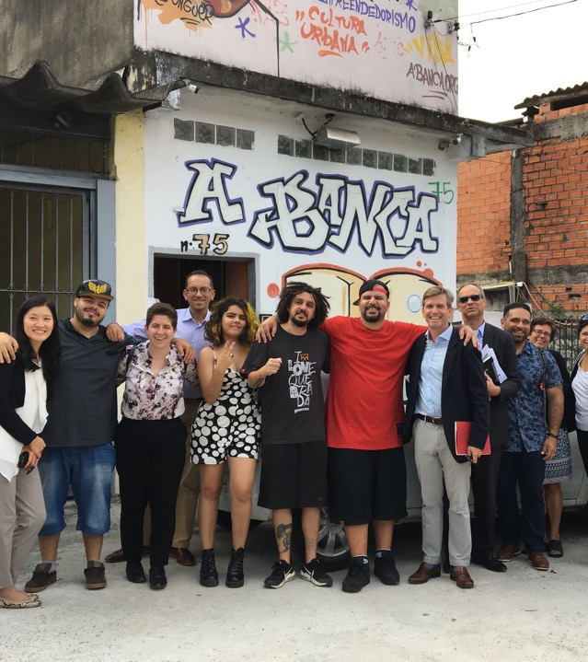
OY peer-led research and data collection to inform GOYN convenings and program design
June, 2020
Welcome!
Please introduce yourself in the chat box.

Slide 2
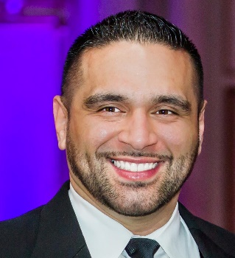
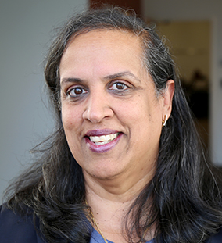

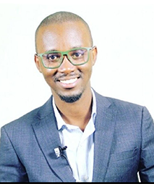
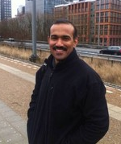
AGENDA
FACILITATORS
Joel Miranda
YouthBuild International
Welcome, introductions, check-in question:
If you could be any animal in the world, what animal would you choose to be and why?
Sangeeta Tyagi, Ph.D.
Brandeis Heller School of Social Policy
2. Participatory Action Research
3. Phase 1 GOYN Community Peer-sharing
Mombasa
Bogota
Pune
GOYN PEER PRESENTERS
María Paula Macías
GOYN Bogota
4. Examples of PAR
Gichobi Stanley Mwangi
GOYN Mombasa
Global Development Incubator
5. How to do PAR with young people within the GOYN context?
Bobby Zachariah
GOYN Pune

Slide 3
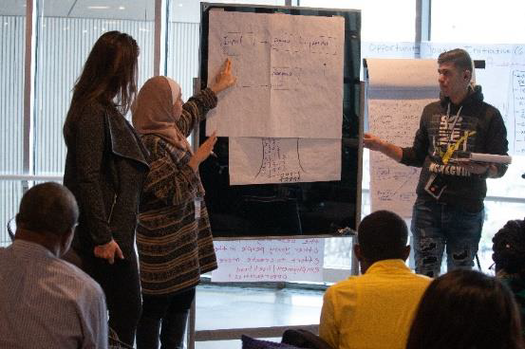
PARTICIPATORY ACTION RESEARCH
(PAR)

Slide 4
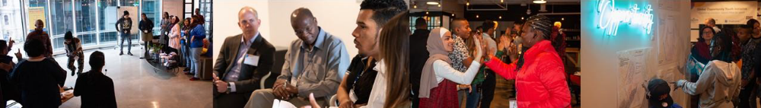
WHAT IS PAR?
PAR is an approach to research.
It is a set of principles and practices for originating, designing, conducting, analyzing, and acting on a piece of research.
PAR brings together researchers and community members to:
Identify problems or challenges the community faces
Empower community members to research and create solutions to those problems
Improve conditions in the community
PAR is driven by a partnership between participants in the community and research partners.
It is collaborative at every stage of the process.
PAR is democratic in its conception, design, and implementation.
The methodology questions the nature of knowledge creation and acknowledges that the process of creating knowledge serves the interests of those in power.
PAR privileges “experience” as a legitimate source of knowing – lived experience as a source of knowledge that can influence practice -- in considering a community problem.
Community knowledge is irreplaceable and provides key insights.

Slide 5
Its purpose is to enable action
It does not de-contextualize the data by separating the data collection from its analysis
How is PAR different from other research?
It examines power relationships critically and trains and empowers the “researched” to become the “researcher”
Creates youth and community buy-in and commitment to the solutions being proposed
Engages them as problem solvers for themselves, their families and their communities
Models true intergenerational partnership and learning process
Enables capacity building and skill development in data collection, analysis, critical thinking, interviewing and other research skills – many of the competencies that help in their overall leadership development
Why is PAR important in our work with young people?

Slide 6
STEPS IN GOOD PAR DESIGN
Cyclical process of change
Action:
Data Analysis
Project Design and Planning
Action:
Data Collection
Reporting
Action and reflection are intertwined at each stage

Slide 7




METHODS USED TO CONDUCT THE RESEARCH:
Within the overall approach, many different methods may be used. Mixed-methods methodology may be appropriate for many topics.
Focus Groups
    How are focus groups different from regular groups?
    Why use a focus group?
    How to run effective focus groups?
Interviews
    How to conduct interviews
Mapping
Steps in effective community mapping
Data Collection
Others, such as Data collection, analysis of data sets etc.

Slide 8
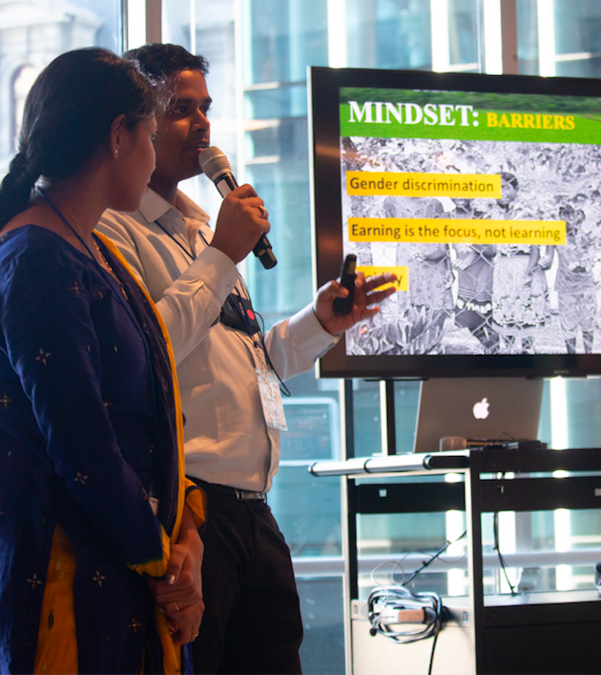
EXAMPLES OF PAR
GOYN Anchor Partner examples
  Bogota
  Mombasa
  Pune
GOYC pre-event youth action research
Youth Justice Coalition YouthBuild

Slide 9
Bogota

Slide 10
Mombasa

Slide 11
Pune

Slide 12
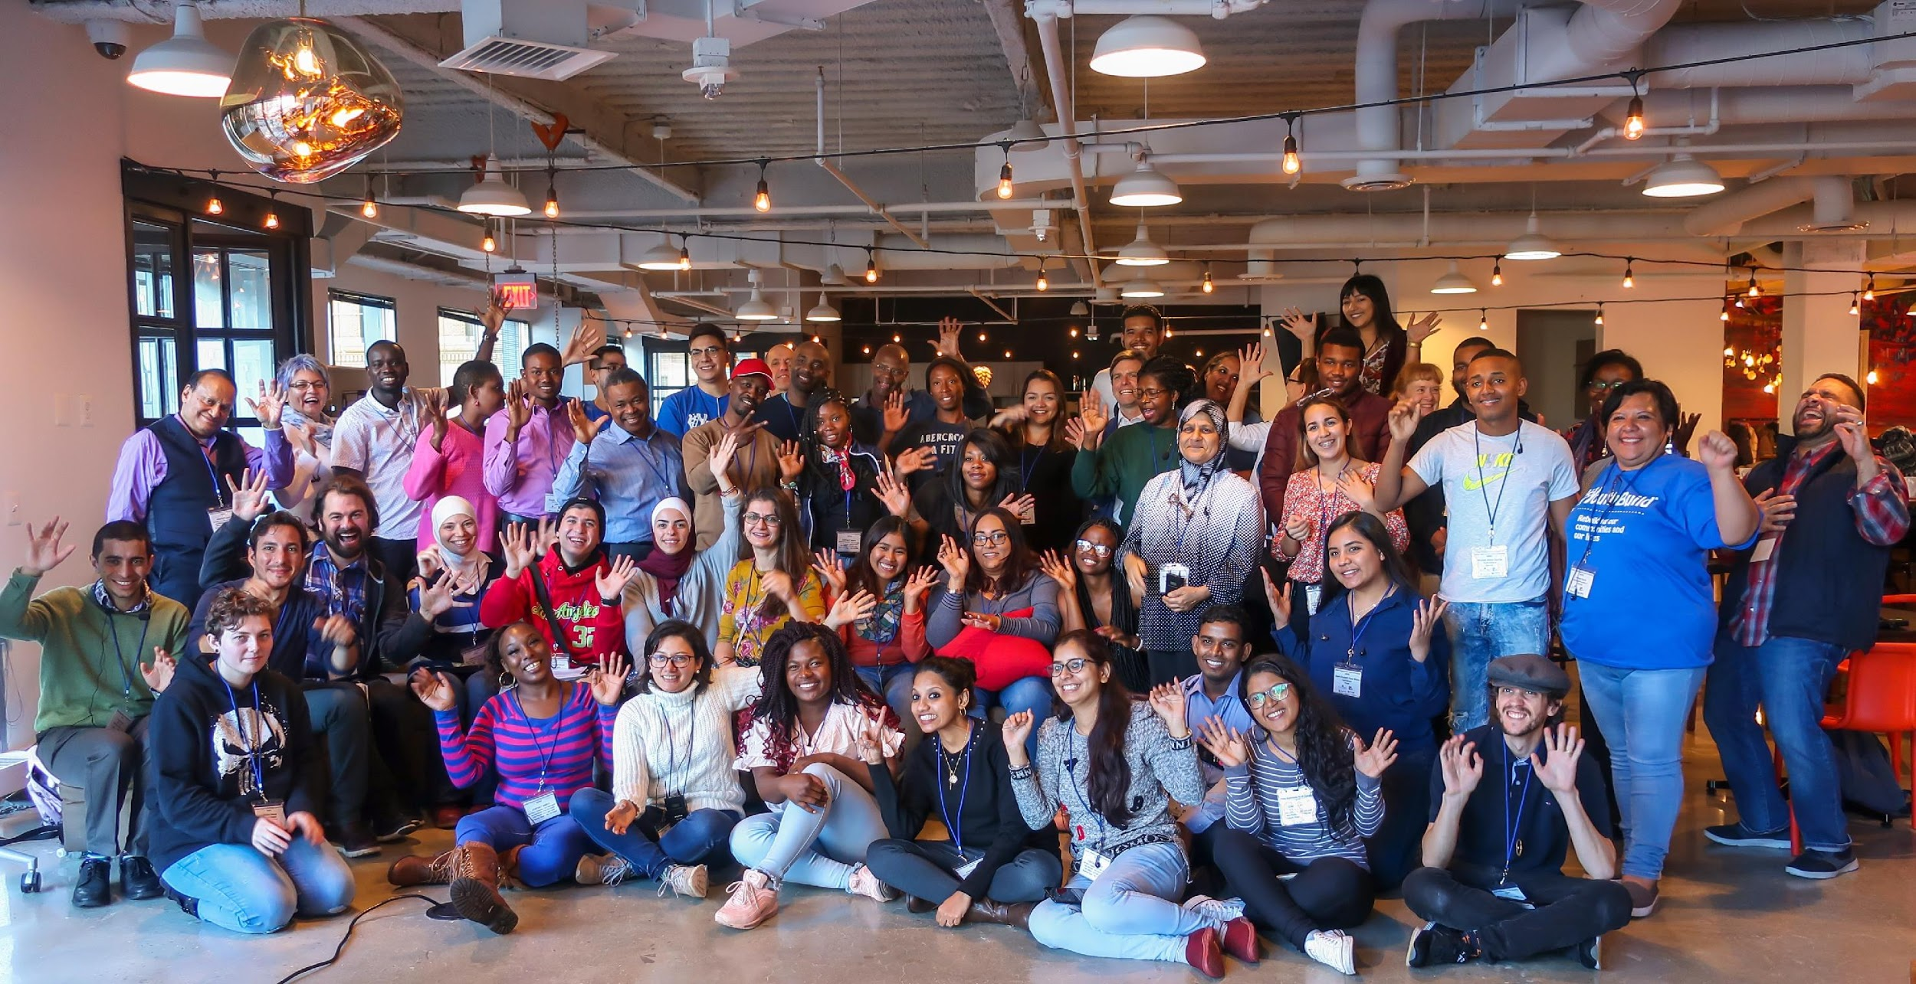
GLOBAL
OPPRTUNITY
YOUTH
CONVENING
YOUTH VOICE
“Nothing about us without us”
Engage Opportunity Youth in co-designing solutions and leading change efforts in communities
Establish an asset-based narrative of this generation of young people that underscores the systemic, rather than individual, nature of challenges youth face.

Slide 13
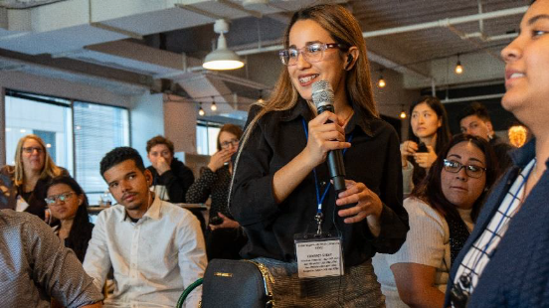
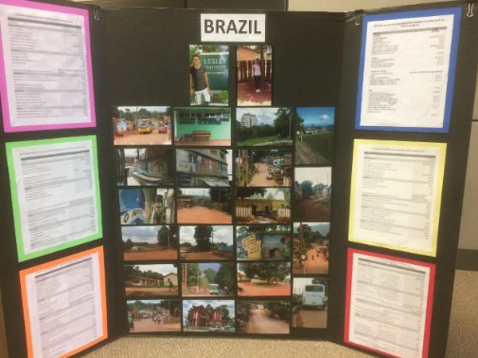
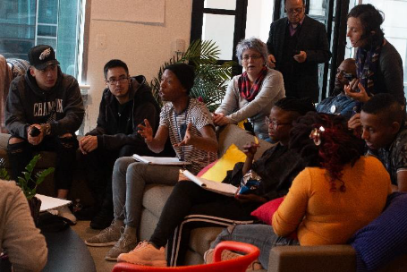
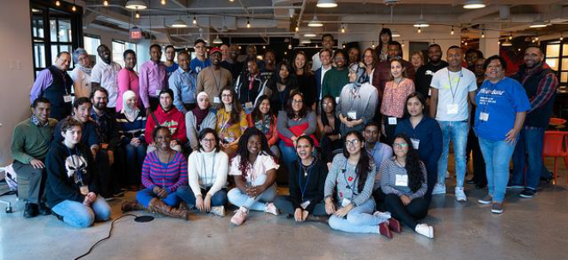
GOYC PRE-EVENT YOUTH ACTION RESEARCH
Delegates were tasked with convening focus group discussions centered on the following questions:
What are the biggest challenges facing young people in your community today?
What are the greatest barriers to employment for young people?
What do you think needs to be done to overcome those barriers? What do you see working in your community that you think should be built upon?
What do you think is the best way to involve other young people in the effort to create more employment/livelihood opportunities?

Slide 14





YOUTH ACTION AGENDA
GLOBAL OPPORTUNITY YOUTH NETWORK
4
Build Capacity
1
Organize, Train,
Inform
Partner
Virtual Exchange
2
Engage
Peer Groups
Engage, Co-create
6
Global OY Exchanges
3
OY Convenings

Slide 15

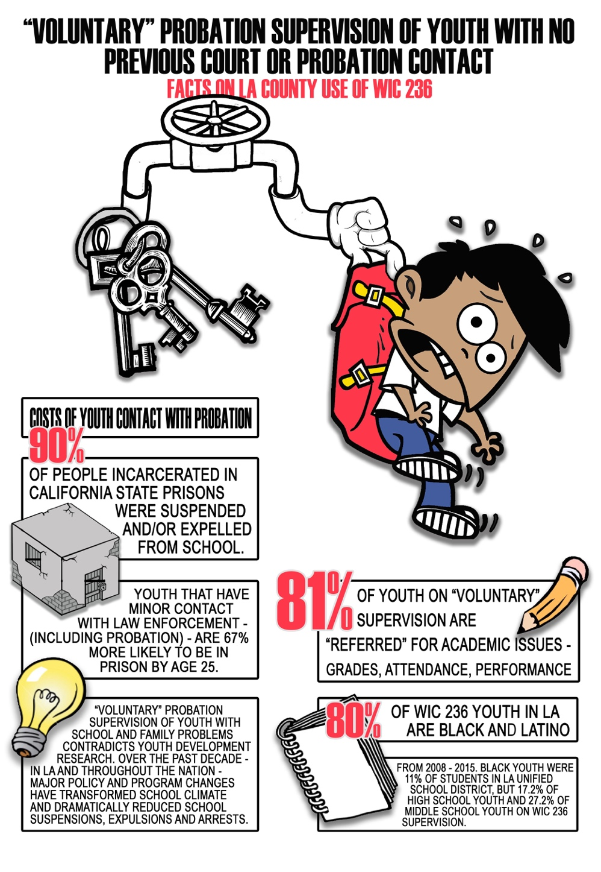

Youth Justice Coalition YouthBuild example

Slide 16
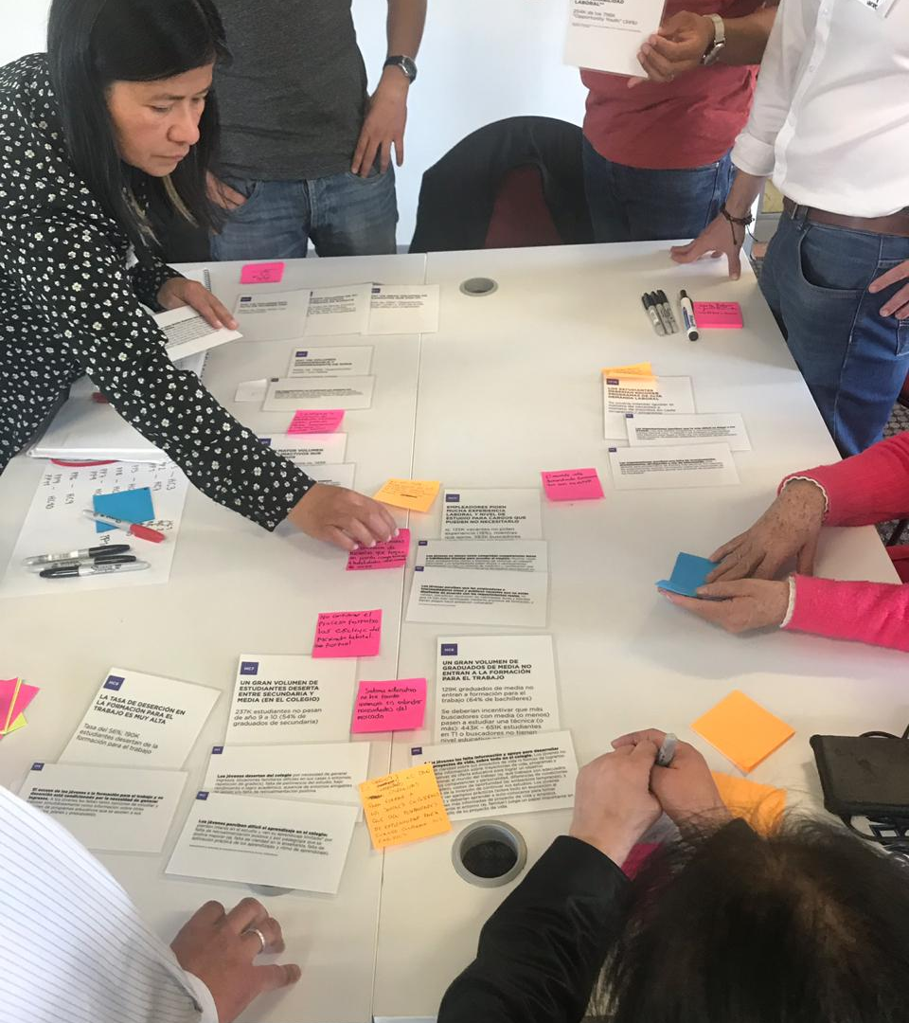
PAR with young people within the GOYN context

Slide 17
Train young people to present the conclusions of their research to appropriate audiences
Include them in the process as you analyze the interviews for themes and trends
Convene young people for an introduction to PAR and application in GOYN
De-brief regularly to lift up challenges and do active problem-solving both on process and content
Train youth in the ethics and code of conduct of conducting research
How do you facilitate PAR with young people within the GOYN context?
Train young people to conduct the interviews, do the observations, lead the focus groups conversations, and document the responses
Train young people to conduct the interviews, do the observations, lead the focus groups conversations, and document the responses
Train youth in the ethics and code of conduct of conducting research
Partner with them to determine who should be interviewed or be part of a focus group
Agree on the design and goals of the research. Clarify outcomes.
Collaborate to design the survey, co-create the interview protocol, or the observation tool
Collaborate to design the survey, co-create the interview protocol, or the observation tool
Agree on the design and goals of the research. Clarify outcomes.
Partner with them to determine who should be interviewed or be part of a focus group
Convene young people for an introduction to PAR and application in GOYN
Conduct a thorough orientation to GOYN. Invite young people and/or YAG members to participate in the PAR process

Slide 18


Slide 19
How will we use PAR in GOYN Global Convening Design?

