Slide 1







Youth Innovation Fund (YIF)
Facilitator
Playbook
Prepared for Global Opportunity Youth Network (GOYN)
Accenture Development Partnerships

Slide 2




What’s in the YIF Facilitator Playbook?
The Facilitator Playbook is a holistic guide crafted to help Anchor Partners in supporting youth innovators on their Design Thinking journey.
It is divided into 5 key sections, to ensure Anchor Partners deliver great and engaging sessions for youth innovators.
2

Slide 3
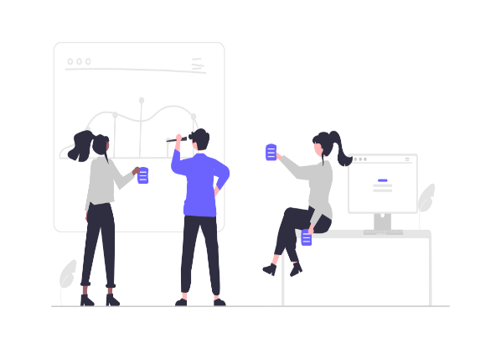





The YIF Facilitator Playbook guide
Preparing for your session
Introducing
your session
Session
delivery
Getting
feedback
Useful
resources
Session checklist
Starting well
How to facilitate with the Toolkit
How to end your sessions
Collaboration tools
Session plan
Online icebreakers
Taking pictures
I Like, I Wish, I Feel
Online libraries & learning resources
Session agenda
In person icebreakers
Delivering a strong presentation
Recording feedback
Session recordings
3

Slide 4

Preparing For Your Session
4

Slide 5



How to prepare for a session
Decide if the session will take place in-person or if it will take place online via Zoom. Use a session plan template to prepare.
1
2
Select icebreakers that work well for your audience and are suitable for where the session will take place.
Select the phase of Design Thinking you will focus on and what tools you will be presenting during the session.
At the end of each session gather feedback from your audience and use these takeaways to improve future sessions.
3
4
5

Slide 6
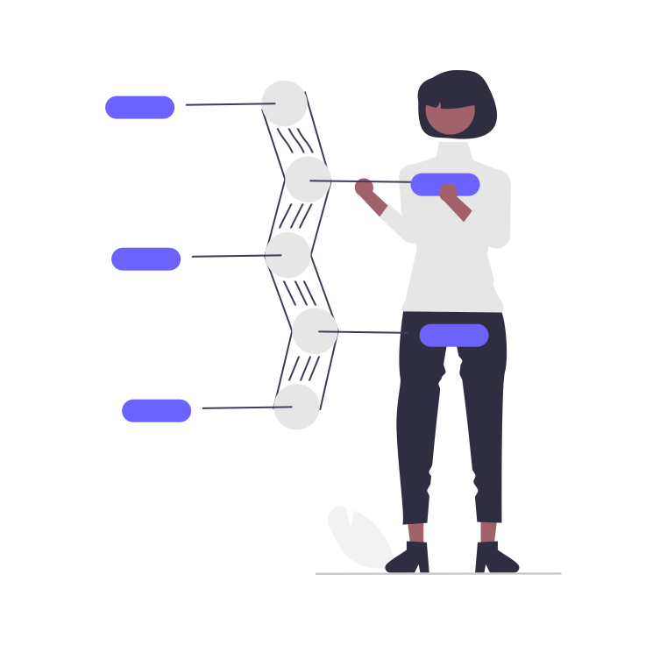

Session checklist
In-Person
Online
Location
Confirm an appropriate venue
Tools for session delivery
Laptop
Wi-Fi/ internet connection (if needed)
Projector
Polling Tools (e.g Menti or Paper methods)
Resources for youth innovators
Design Thinking Toolkit
Paper & Pens
Location
Zoom invite sent to participants
Tools for session delivery
Laptop
Wi-Fi/ internet connection
Polling Tools (e.g Menti)
Resources for youth innovators
Design Thinking Toolkit
Paper & Pens
6

Slide 7



Session plan template
Session Title:
Date and Time:
Location (In-Person or Online):
Participants:
Goals and Objectives:
What Design Thinking Tools will youth innovators learn:
Any other Important information:
7

Slide 8

Session plan example
Session Title:
Date and Time:
Bringing your ideas to life
12 Sep 2022, 4-6pm
Location (In-Person or Online):
Participants:
Online
12 youth innovators
Goals and Objectives:
What Design Thinking Tools will youth innovators learn:
To introduce the youth innovators on ways that they can bring their ideas to life.
Paper Prototyping
Storyboard Prototyping
Live Prototyping
Any other Important information:
We need to ensure all participants have access to a stable Wi-Fi connection to participate in the session.
Zoom invites should be sent 2 weeks prior to the event.
Complete PowerPoint which will be presented during the session
8

Slide 9
Session agenda template
Session Title
Time:
(How long will each activity take?)
Activity:
(What will the session cover end to end?)
Resources needed:
(List all the materials and technology needed for each activity)
9

Slide 10

Session agenda example (online)
Bringing your ideas to life: Prototyping
Time:
(How long will each activity take?)
4.00 – 4.10PM
4.10 – 4.25PM
4.25 – 4.40PM
4.40 – 4.50PM
4.50 – 5.05PM
5.05 – 5.35PM
5.35 -5.45PM
5.45 – 6.00PM
Activity:
(What will the session cover end to end?)
Welcome and Introduction
Icebreaker
Prototyping and Paper Prototyping
BREAK
Storyboard and Live Prototyping
Group Activity or Individual Task
Group Presenting/
Examples
Feedback and Close
Resources needed:
(List all the materials and technology needed for each activity)
PowerPoint
PowerPoint
PowerPoint
PowerPoint
Breakout Rooms
PowerPoint
10

Slide 11

Introducing Your Session
11

Slide 12


Starting your sessions well
To keep your audience engaged in your session from the very beginning, it is important to start your sessions well. Here are 2 key areas to help you with this:
Introductions
Icebreakers
Icebreakers are quick and engaging activities that can help your audience get to know one another.
They are also useful in welcoming attendees and creating a relaxed environment.
On the following pages, you will find examples of icebreakers that can be used in your sessions.
A strong introduction to a session should be clear and concise and it should include:
An intro to you – this is important if it is your first time working with the audience
A summary and agenda of the session
Group/audience intros – giving everyone the chance to introduce themselves works if it is a small group
12

Slide 13

Icebreaker 1: Two truths and a lie
Online
Two Truths and Lie is a fun icebreaker that encourages participants to get creative.
How to Play:
Each participant shares 2 facts about themselves (these are truths) and one lie.
The rest of the group will try and figure out which is the lie out of the three given statements.
This icebreaker helps players learn a little more about each other and hopefully adds a lot of laughs. You’ll surely be surprised by the truth!
Duration:
This icebreaker takes around 5 minutes for participants to think about their 2 truths and 1 lie and 3 mins per person for presenting to the group.
If you have a larger group you may not have enough time to go through each participant, so select 2-3 volunteers.
13

Slide 14
Icebreaker 2: Virtual share and tell
Online
Virtual Share and Tell is a great team building activity to help participants get to know each other
How to Play:
Each person in the group will have the opportunity to talk about a prized possession or a personal achievement that they are proud of with the rest of the team.
It can be anything from a personal hobby to professional projects.
This activity can be done as a larger group, smaller group or in pairs.
Duration:
This icebreaker takes around 5 minutes for participants to think about what they want to share and 2 mins per person for presenting to the group.
If you have a larger group you may not have enough time to go through each participant, so select 2-3 volunteers.
14

Slide 15
Icebreaker 3: Emoji of the week
Online
Emoji of the week is another great icebreaker that helps participants get to know one another better.
How to Play:
Each person, will send an emoji in the chat function that describes their week.
If it’s a small group, each participant can share what the emoji meant to them and why they selected it.
For larger groups the facilitator can select 2-3 volunteers to share more about their week and the emojis they selected.
Duration:
This icebreaker takes around 2-3 minutes for participants to share an emoji.
15

Slide 16


In Person
Icebreaker 4: Meet and greet
Meet and greet is an icebreaker that encourages 1:1 conversations with participants
How to Play:
Split the group in pairs and arrange two lines of chairs facing (this can also be done in a circle).
Set a timer of 3 minutes for each pair to chat and get to know one another.
Once the 3 minutes are up, ask one row to move along to the next chair and reset the timer for another 3 minute conversation.
It’s unlikely that everyone will talk but it’s a fun and interactive way to get people talking.
Duration:
This icebreaker takes a total of 10 minutes, for 3 rounds. This time can be amended based on what is suitable for your group.
Resources:
You will need chairs, but this icebreaker can also be done standing if the total duration is not too long.
16

Slide 17
Icebreaker 5: Stranded
In Person
This activity is not only great for getting the group to talk, but it also applies problem solving skills and gets participants thinking outside the box.
How to Play:
Split the group into smaller groups of 3-6 and tell them that they are stranded on a deserted island. As a group, ask them to think of 3 things they will take with them to the deserted island and explain why.
Have a volunteer from each group present the 3 things their team selected with the wider group.
Duration:
This icebreaker takes a total 5 minutes for the groups to discuss and presentation can take 3 minutes for each group.
Resources:
Pen and Paper (optional).
17

Slide 18
Icebreaker 6: Create your own icebreaker
In Person or Online
Another great source of icebreakers can be from the youth innovators themselves.
How to Play:
After 2 or 3 sessions, once youth innovators have had experience with a few different icebreakers, give them the take-away task of generating their own icebreakers.
For the “Create your own icebreaker” activity, participants can be split into groups of 2-4 and given the objective of creating their own icebreaker idea. They will need to consider instructions on how to play it, how long it will take and what resources will be needed.
Duration:
For “Create your own icebreaker”, groups can be given 15 minutes to create and 5 minutes to share their ideas with the wider group. Participants can vote for their favourite icebreaker and this can be used in the following session.
Resources:
Pen and Paper (optional).
18

Slide 19

Session Delivery
19

Slide 20

How to facilitate with the Design Thinking Toolkit
While we have suggested ways to facilitate with the Design Thinking Toolkit, we also encourage you the generate your own ideas and methods of facilitation. Below are some tips that will help you in your facilitation journey.
Personalise it to your style of delivery
Always make time for discussions, questions and activities.
Make sure you tailor the content to your audience
20

Slide 21




Delivering a strong presentation
Tailor to your Audience
Use examples that your audience will be able to relate with.
Start well
Introduce your presentation clearly and share an agenda session, so your audience know what to expect.
Avoid too much text
When putting slides together be conscious of how much text you put on one slide.
Make it interactive
This can be done by making time for discussions or questions in your sessions.
Use engaging visuals
Use images and videos to share concepts and to make your presentation engaging.
21

Slide 22


Taking pictures during your sessions
Here is some advice on how to go about taking pictures during your sessions.
1
Before taking any pictures be sure to inform all participants and get their consent. Let participants know you will be taking pictures, what they will be used for and give them the option to opt-out.
2
It really helps to have someone assisting you to take pictures, so you can focus on facilitating. If this isn’t possible, aim to take pictures at the start, end, and during activities.
3
Group Pictures – A great time to take group pictures is at the start or end of your session.
4
Remember to take pictures of any work that is produced during the session e.g. Posters, Paper Prototypes etc.
22

Slide 23

Getting Feedback
23

Slide 24


How to end your sessions
A great way to end a session is by getting feedback from participants. This can give you insights into what they enjoyed, while learning about potential areas of improvement.
Value of Feedback
Get Feedback
Make Changes
Deliver better sessions
After getting feedback, you can end the session by:
Sharing next steps
Sharing how participants should prepare for the next session
24

Slide 25
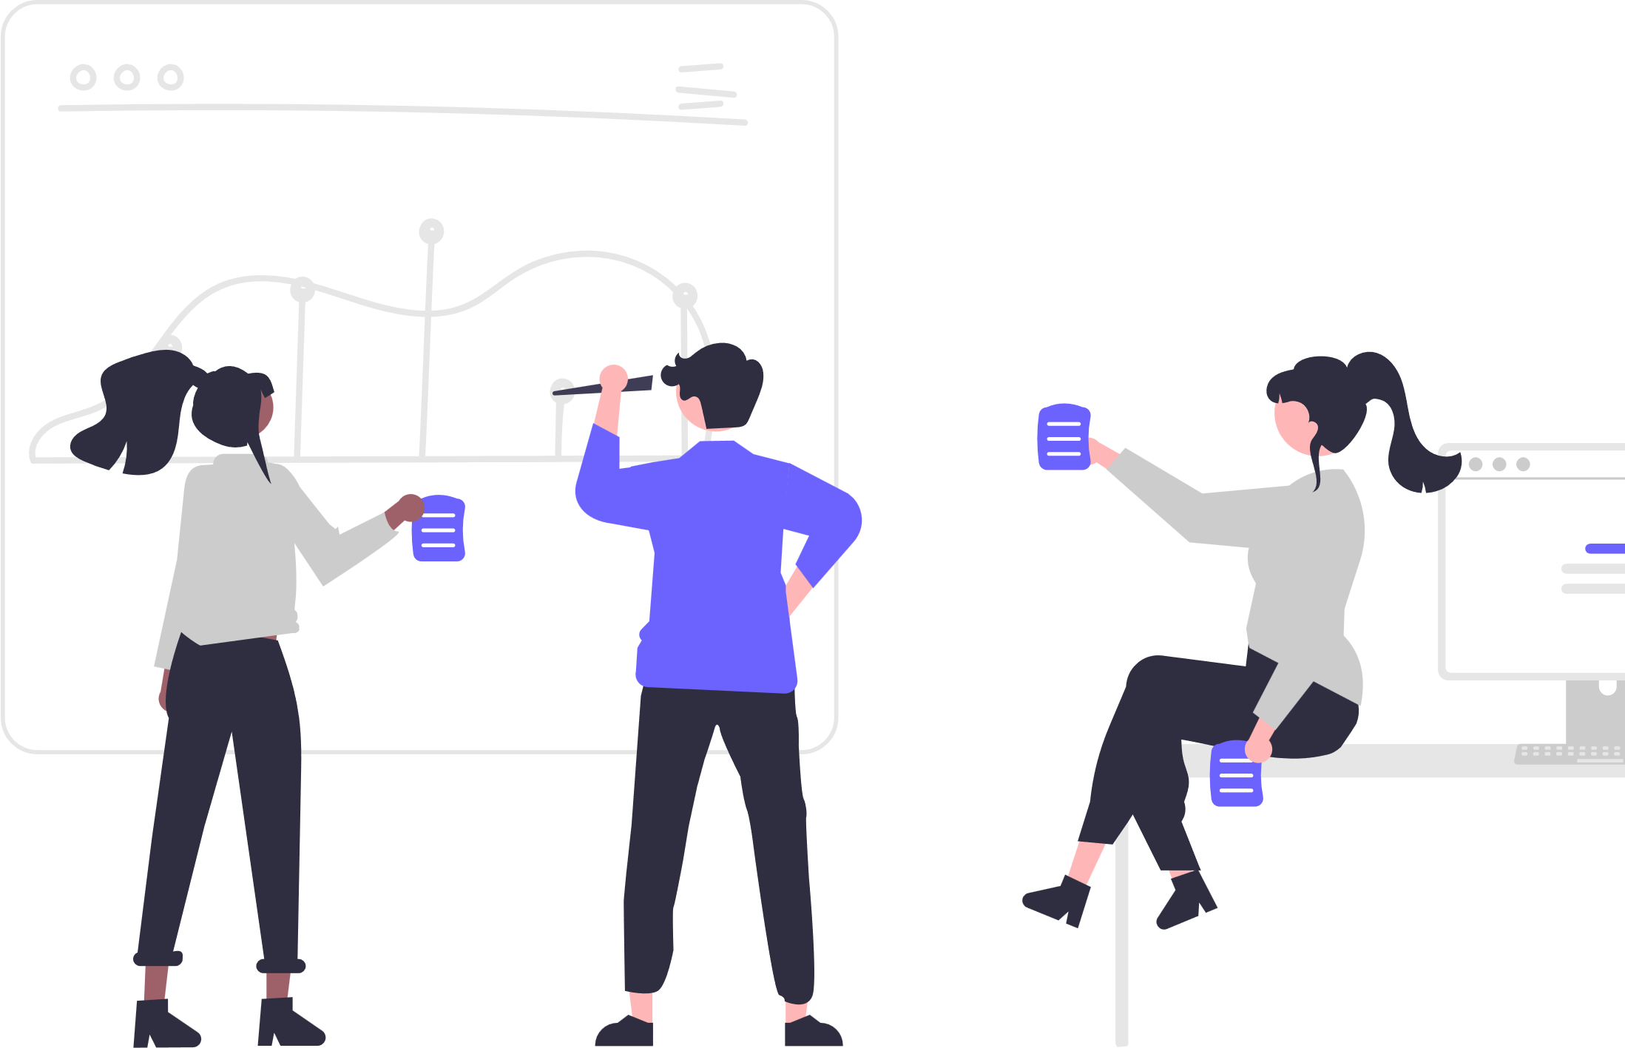
I like, I wish, I feel
A quick way to gain feedback at the end of the session is through the ‘I like, I wish, I feel’ method.
How does it work?
Make 3 columns and title them, ‘I like’, ‘I wish’ and
‘I feel’ on a whiteboard, paper or presentation slide.
If in person, provide participants with 3 sticky notes and a pen. Allow time for participants time to write one thing they liked about the session, something they wish was different about the session and one thing they feel about the session.
Once they’ve all written their thoughts down, group common themes together and discuss with participants.
Duration:
This activity can take a minimum of 15 mins
Resources:
Sticky Notes and a Whiteboard or Large Paper (if in person)
Chat Function, Menti or Mural (if online)
25

Slide 26

Recording feedback during your sessions
Here is some advice on how to record feedback throughout your sessions.
Have someone to assist with notetaking, to note down important feedback and suggestions during discussions.
If you are conducting an online session, recording the session is a great way to capture feedback and discussions.
You can also use tools that help with written feedback. For example, using paper and pens, or digital resources such as Menti and Mural.
26

Slide 27

Useful Resources
27

Slide 28

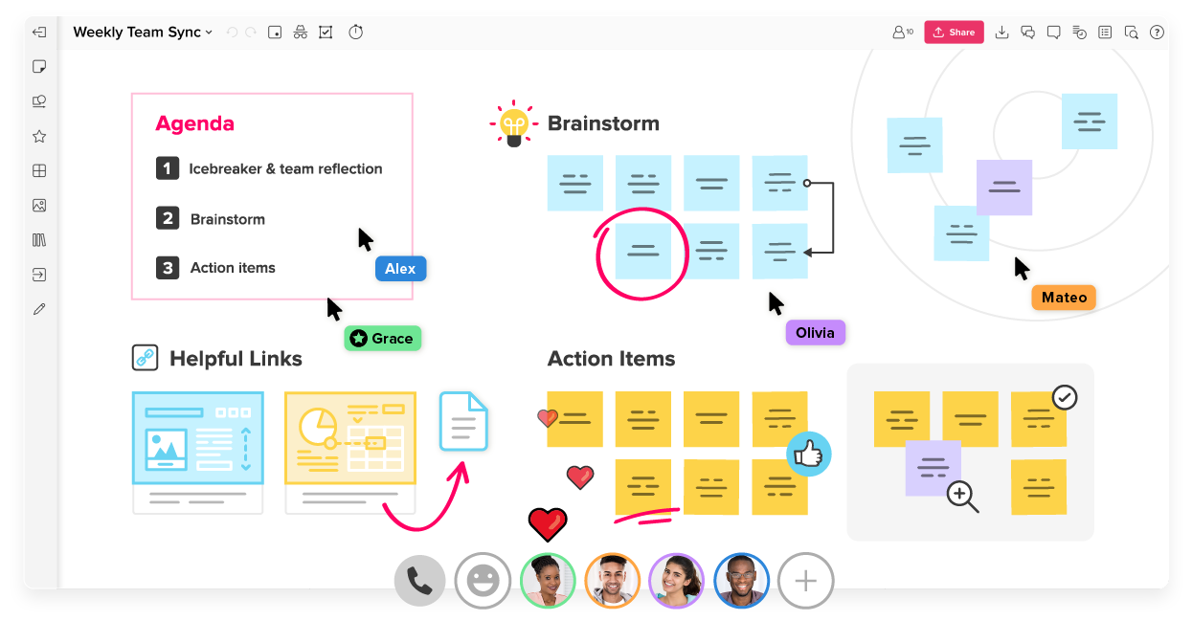

Introduction to MURAL
Mural is an online whiteboarding tool that mimics the activity of workshops in a digital environment. The ability to conduct collaborative sessions in an interactive, engaging way allows people to connect in real time and co-create new solutions.
Mural is the best tool to facilitate remote workshops for the following reasons:
Friendly user interface
Mural’s templates and tools align with the approach and methods required to design and co-create
Cross-tech capabilities (Zoom, Microsoft Teams integration)
28

Slide 29

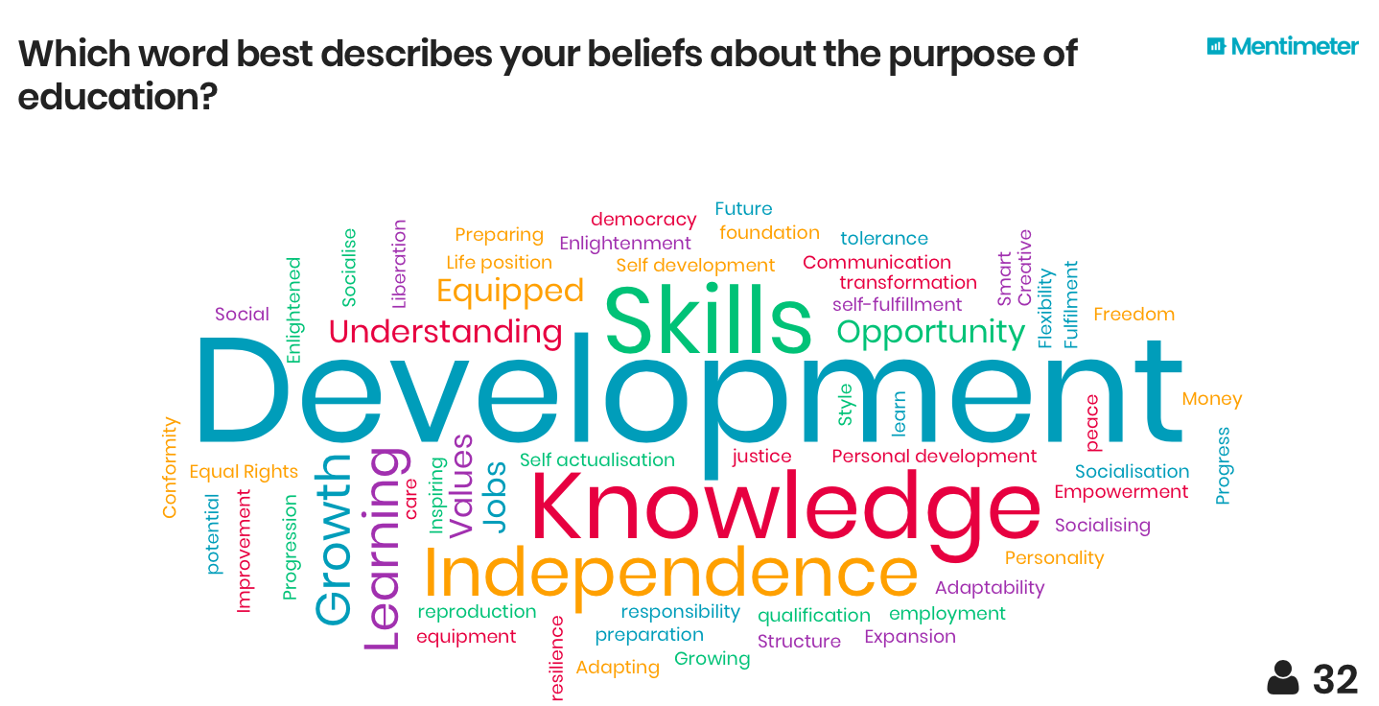
Introduction to MENTI
Add polls, word clouds, Q&As and more to your presentations and create an interactive experience for your audience. Your audience can use their computer or smartphones to vote on questions and engage with the presentation.
Menti is a quick and easy tool to collaborate and keep an audience engaged, because:
All you need to participate is a phone/computer with internet access
Involves the audience in your presentation when given the chance to decide on an outcome
Boosts efficiency through collaboration, and makes it quicker to generate content or data
You can access a basic FREE version
29

Slide 30

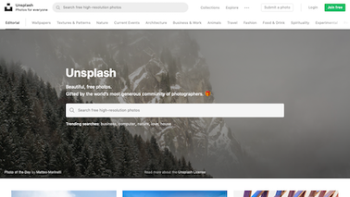
Introduction to UNSPLASH
Unsplash offers over 3 million free high-resolution images that can be used in your presentations.
UNSPLASH can be used to search for images for your presentation, at the click of a button.
It is completely FREE.
Use the search bar to type the theme of the images you are looking for.
Have access to millions of pictures, across many different themes.
All images on Unsplash are of a high quality and resolution and can be resized without any impact to quality.
30

Slide 31

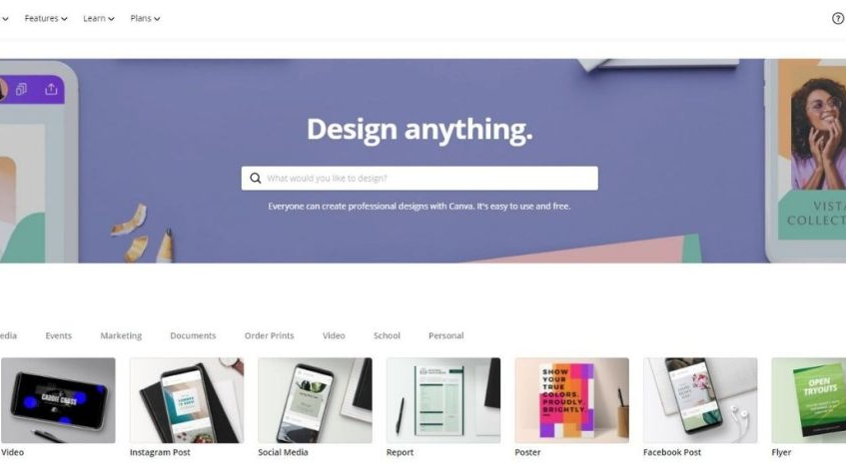
Introduction to CANVA
Canva is an easy-to-use graphic design platform that can be used to create almost anything digital.
CANVA is great for creating social media graphics, presentations, documents and other visual contents.
Easy-to-use editing features.
Select from one of their visual templates to customise visually engaging content.
You can also use the platform to develop graphics from scratch.
31

Slide 32


Kidovation’s guide to Design Thinking and innovation
Here you can find a link to a playlist of 15 Design Thinking Videos produced by Kidovation
Click Here
32

Slide 33
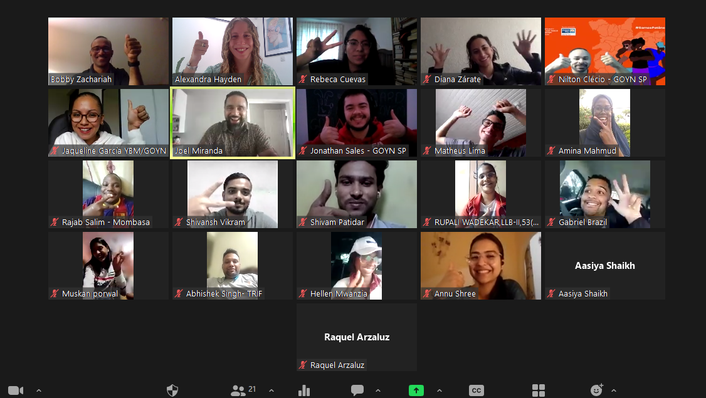
Design Thinking Toolkit pilot sessions
Here are the links to the recordings of the Design Thinking Pilot Sessions
Session 1 – Kick-Off and Discover & Define
(CLICK HERE)
Session 2 – Design & Build
(CLICK HERE)
Session 3 – Measure & Learn
(PART 1 & PART 2)
33

