Slide 1







Youth Innovation Fund (YIF)
Handbook
Prepared for Global Opportunity Youth Network (GOYN)
Accenture Development Partnerships

Slide 2




What’s in the Youth Innovation Fund (YIF) Handbook?
The YIF Handbook aims to provide youth innovators with all the key information they need to know about the YIF programme.
What is the YIF Handbook?
The YIF Handbook provides an overview of the programme including the objectives, timelines, previous projects and profiles of youth innovators.
2

Slide 3

The YIF Handbook guide
The below provides an outline of what you will find in the YIF Handbook.
YIF Overview
YIF Application Details
Project Spotlights
GOYN youth innovators
3

Slide 4
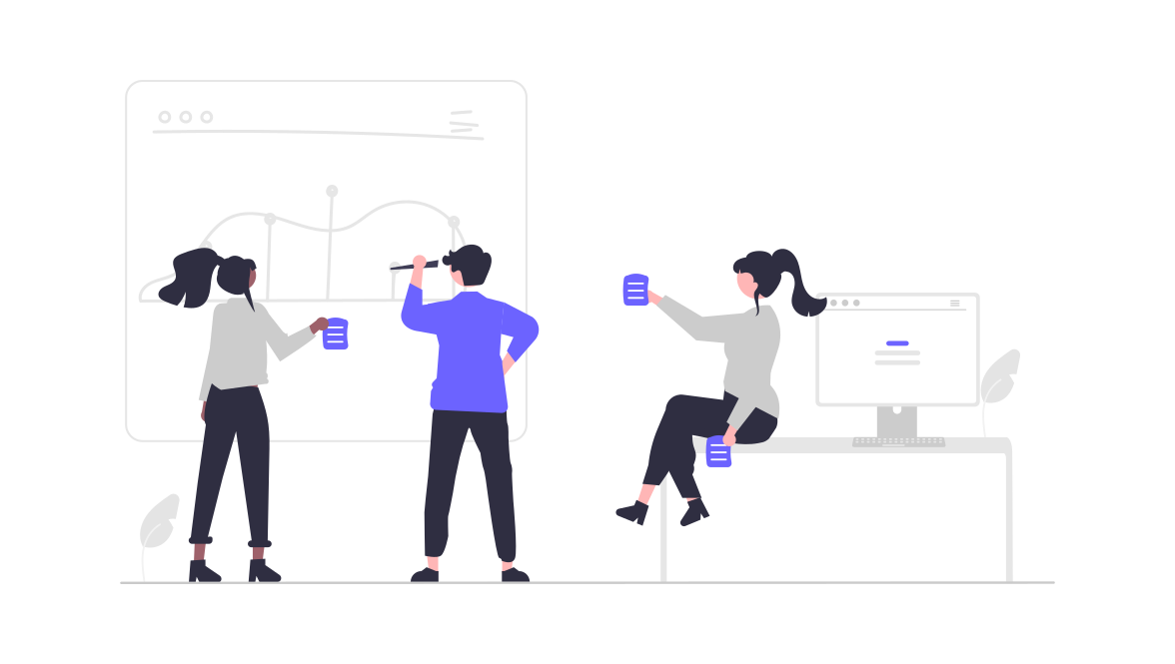

YIF Overview
4

Slide 5

The YIF journey
The below shows you what will happen from the start to end of your YIF journey.
Months 1 - 4
Application & Selection
Complete and submit your YIF application.
Months 6- 8
Capacity Building Sessions
Design Thinking skill building sessions led by Anchor Partners.
Months 9 - 12
Building & Evaluation
Using the knowledge from the skill building sessions, develop your ideas and evaluate the progress.
Month 5
Community Launch
Local announcement of selected projects.
5

Slide 6




The YIF timeline
There is not a global start date for the YIF as communities are encouraged to launch and manage the programme on a local level.
Application & Selection
Launch
AP Capacity Building
Building & Evaluation
Month
1
2
3
4
5
6
7
8
9
10
11
12
Call for proposals
Young people with concepts at different stages of development are encouraged to apply to YIF.
Local & global reviews
In month 2, Anchor Partners shortlist projects, using the scoring rubric.
In month 3, the global review takes place, and in months 4-5 concepts are shortlisted
Community launch
Selected projects are announced.
Anchor Partner capacity building sessions
Skill building sessions that are more specific to the local contexts of YIF projects, based on the Design Thinking Toolkit.
Building & developing
YIF projects are developed and launched.
The impact of projects is evaluated.
Continuous Evaluation
Across the course of the YIF, continuous evaluation and impact measurement will take place, in month 1, 6 and 12. This will provide the opportunity to gain key insights in the learning and development journey of the YIF participants.
Quarterly YIF Calls
Every quarter a Global YIF call will take placee, this will be an opportunity for all the communities to come together and share Community Project Spotlights.
6

Slide 7



The YIF goals
1
Catalyse opportunity-youth led actions that address the barriers that young people face to productive, quality livelihoods in their local communities and countries.
2
To train teams of local youth leaders in the skills required to plan, design, launch and manage local action projects; and to link these teams across national geographies.
3
Incentivize youth analysis and mapping of barriers to productive livelihoods; coupled with access to institutions, data and adult allies who can help young people to build this analysis.
4
To enable experimentation and innovation at the local level, that can populate a searchable global bank of youth-led innovation managed by the GOYN.
7

Slide 8
YIF
Application
Details
8

Slide 9


Grant amounts & disbursal
Grants will range between the equivalent of $100 - $500 USD for projects that engage up to 100 youth.
Grants up to the equivalent of $1,000 USD will be considered for larger projects that are organized by a team of young people from multiple communities or organizations and engage over 100 youth.
All projects will be executed over a 3-month period. During this period youth innovators will receive ongoing guidance, support, and capacity-building from the GOYN Anchor Partner and YBI.
9

Slide 10

Use of funds
On behalf of GOYN, YouthBuild International will distribute funds to the local GOYN Anchor Partner. The local GOYN Anchor Partner will then disburse funds to vendors, or incur costs, for project related expenses on behalf of the YIF youth innovators.
Funds must be used to cover costs of carrying out a youth-created and youth-led project that addresses local challenges related to equity, sustainability, and access to meaningful livelihoods.
Funds can be used for:
Meeting or event space
Meeting, project, or event supplies
Food for meetings or events
Transportation costs related to planning and execution of a project
Funds may NOT be used for:
Business/entrepreneurial startup cost
Alcoholic beverages for project related events
GOYN Anchor Partner or sponsoring org salary
GOYN Anchor Partner or sponsor org costs not related to a YIF funded project
GOYN Anchor Partner or sponsoring organization overhead and administrative costs
10

Slide 11

Eligibility requirements
The ideal Youth Innovations Fund grantee is a young person or group of young people who has a positive reputation as a trusted young leader or group in their community and is participating in, or contributing to, the goals and objectives of local GOYN member organizations and partners.
Youth Innovation Fund applicants must be between the ages of 18 and 30, and identify with at least one of the following categories:
Living in poverty; experiencing generational poverty
Have been cut-off from opportunities due to membership in a specific community or demographic
Geography, racial, ethnic, religious, gender, LGBTQ, disabled youth, and youth living with HIV/AIDS –
Currently or previously experienced barriers to meaningful education and employment opportunities as a result of their lived experiences
11

Slide 12




YIF criteria
Grants of $500 - $1,000 USD will be awarded to projects that meet the following criteria:
Projects must align and promote at least one of the three United Nations Sustainable Development Goals listed below:
12

Slide 13
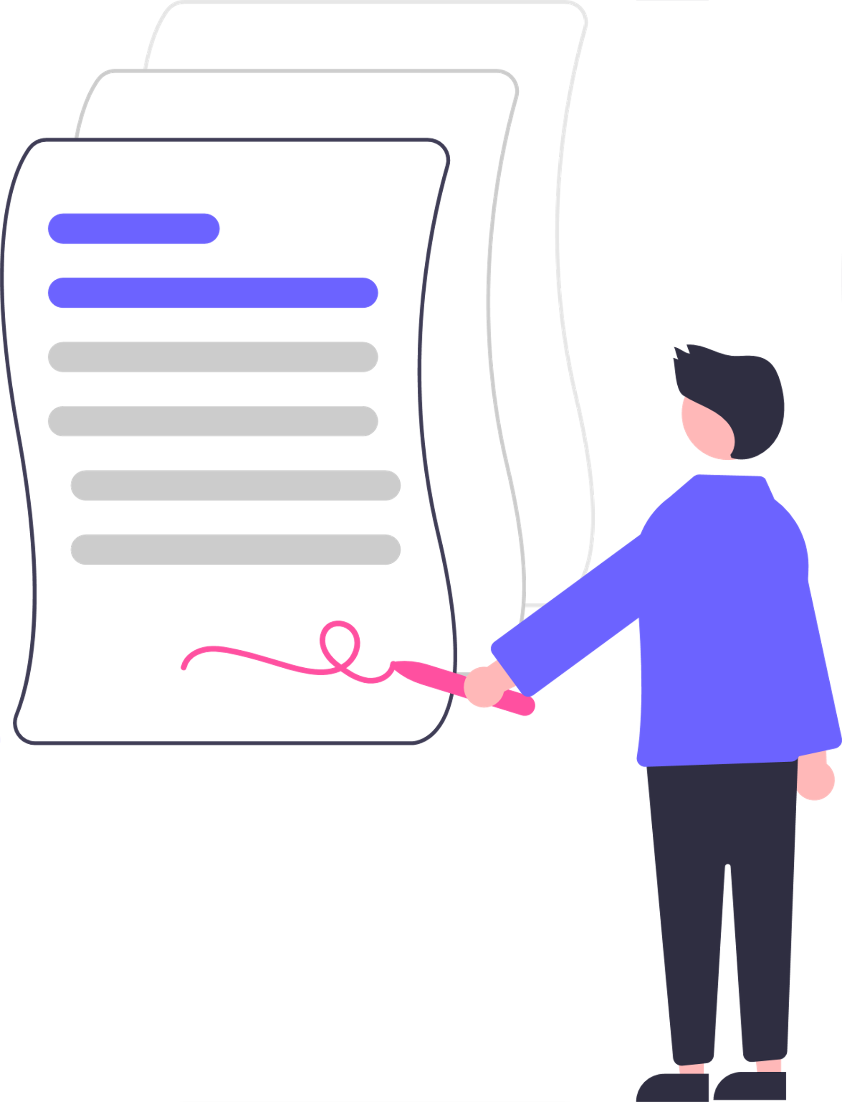
Selection requirements
If you are selected for the programme you must agree to the following:
You will attend a mandatory YIF grantee orientation.
You are willing to act as an Ambassador for the GOYN
You will connect with local GOYN member organizations, partners, and youth to participate in the YIF funded project
You will share bi-weekly updates, and communicate regularly via phone, text, email, or virtual conference with the GOYN Anchor Partner and the GOYN Global YIF team. We will setup a schedule of calls with Anchor Partners and GOYN Global team during the orientation webinar for selected youth innovators.
You will participate in the GOYN Global Virtual Convening, exchanges, and professional development workshops
You will provide detailed reporting of your project and documentation of spent funds (receipts, invoices, etc.). Templates for the reports will be reviewed and shared during the orientation webinar for selected youth innovators.
If selected as a finalist, you will provide a 1-2 minute video introducing yourself, describing your project, and your vision for the future of your community.
13

Slide 14

Preparing for the application
In preparation for the application consider the following areas:
A description of your project
How your project addresses the SDG goals and issue area you have selected?
What is your intended impact?
How will you organize other youth and members of the community to participate in this project?
What will young people or others in the community know or be able to do as a result of your project?
How will you know that your project was successful?
How will your project be completed?
14

Slide 15

Project Spotlights
15

Slide 16











YIF: Round 1
36 youth-led projects across six communities
Selection
234 projects proposed by over 500 OY
29 projects selected through global review
7 supported through local funding partners
Key Issue Areas Identified by youth innovators:
Racial Inclusion in Livelihood Pathways
Addressing Gender Based Violence (GBV)
Gender Equity
LGBTQI+ Rights and Access to Jobs
Livelihood Access for Migrant and Immigrant Communities
Environmental Justice (Education and Sustainability)
Decreasing Barriers to Entrepreneurship Opportunities
Inclusion of Differently-Abled Young People in Livelihood Pathways
Inclusion in Arts and Creative Economy
Bogota Engaging Black and Afro-Colombian OY through arts Public policy training for youth by youth Women’s health and violence prevention Advocacy for young women and migrant communities | Sao Paulo Boost circular economy; conscious consumption, environmental education, and local production Alternative source of local income through returnable collection and recycling residential waste Decreasing social barriers for LGBTQIA+ OY | Ethekwini Raising awareness about gender-based violence Computer coding project for youth in Cato Manor region Education and promotion of indigenous plant biodiversity Mental health awareness and support for OY in Newlands West
Mombasa Restoring green spaces Training on creation of sustainable re-usable sanitary pads Workshops: sexual and reproductive health, teen pregnancy, and gender-based violence | Pune Self-defense training for women and sensitization groups for men Job skilling for young women through jewelry making and appliance repair Education campaign related to the value of differently- abled OY | Ramgarh Digital media to raise awareness of COVID safety measures and precautions Campaign to introduce clean energy alternatives in sewing cluster Raising awareness on the importance of regenerative and sustainable farming
16

Slide 17












YIF: Round 1
36 youth-led projects across six communities
Bogotá, Colombia
Engaging Black and Afro-Colombian Opportunity Youth through arts
Public policy training for youth by youth
Women’s health and violence prevention
Advocacy for young women and migrant communities
Mombasa, Kenya
Restoring green spaces
Training on creation of sustainable re-usable sanitary pads
Health and gender-based violence workshops
Pune, India
Self-defense training for women and sensitization groups for men
Job skilling for young women through jewelry making and appliance repair
Education campaign related to the value of differently- abled Opportunity Youth
Sao Paulo, Brazil
Boost circular economy, conscious consumption, environmental education, and local production
Alternative source of local income through returnable collection and recycling residential waste
Decreasing social barriers for historically marginalized groups
Ethekwini, South Africa
Raising awareness about gender-based violence
Computer coding project for youth in Cato Manor region
Education and promotion of indigenous plant biodiversity
Mental health awareness and support for Opportunity Youth in Newlands West
Ramgarh, India
Digital media to raise awareness of COVID safety measures and precautions
Campaign to introduce clean energy alternatives in sewing cluster
Raising awareness on the importance of regenerative and sustainable farming
17

Slide 18

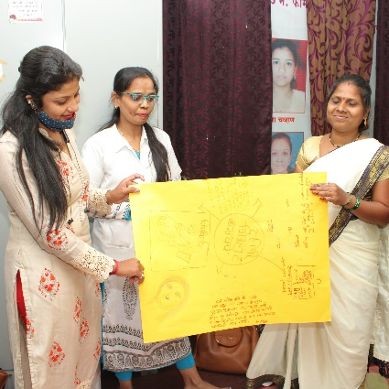
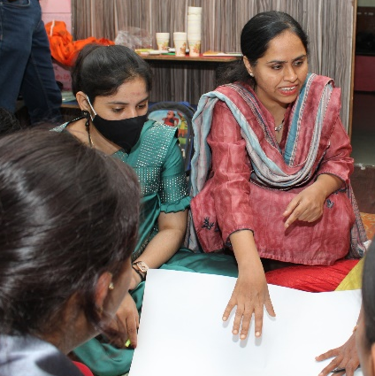
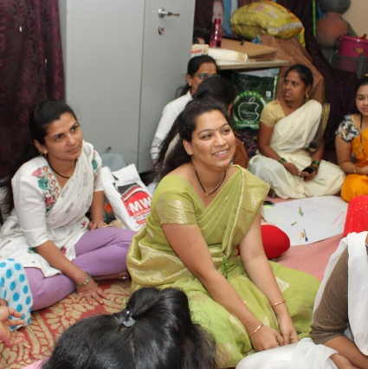

Mombasa,
Kenya
18

Slide 19

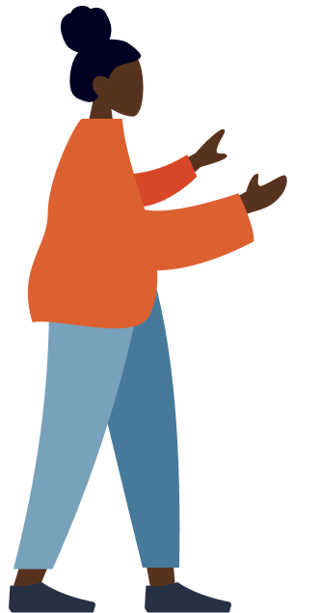





Project spotlight: Green spaces
Project Community: Mombasa, Kenya
Project Aim:
To increase awareness of appropriate waste management strategies amongst the inhabitants of Moroto slums in Mombasa.
What the team did:
The team conducted waste management training targeting 118 community members. The community members were sensitized to different waste disposal, sorting, and recycling during the training.
Project Outcomes:
Next Steps:
The community has revived some forgotten waste collection sites and set up weekly cleaning exercises. The team has further established a mangrove trees nursery that has currency over 10,000 trees and targets 100,000 trees over the next six months.
The mangrove trees will be distributed to the community members for planting and as an income generation activity.
19

Slide 20
Project spotlight: Bahari community hub
Project Community: Mombasa, Kenya
Project Aim:
To increase awareness of appropriate waste management strategies amongst the inhabitants of Moroto slums in Mombasa.
What the team did:
The team conducted waste management training targeting 118 community members. The community members were sensitized to different waste disposal, sorting, and recycling during the training.
Project Outcomes:
The Bahari team has been allocated an office at their local chief's office to run their activities more smoothly. The team has also received several other partnership requests from other organizations, with Tech Bridge, an incubation hub providing a three-month incubation of the initiative. In addition, it will see them receive three sewing machines to support the young mothers with skills building.
20

Slide 21
Project spotlight: Reusable sanitary towels
Project Community: Mombasa, Kenya
Project Aim:
To enhance girls' access to and knowledge of reusable sanitary towels and improve menstrual hygiene practices to improve sanitation, hygiene, and dignity amongst girls in Changamwe Sub County.
What the team did:
The team supported 20 girls with training on making reusable towels and, in turn, produced 200 pieces of reusable towels.
Project Outcomes:
In collaboration with the local administration, the group further mapped out 150 marginalized girls who received the sanitary towels. Through this collaboration, the team provided sensitization to over 200 girls on menstrual hygiene practices, a practice that they continue delivering beyond the project's life.
21

Slide 22
Project spotlight: Amazing people with disabilities
Project Community: Mombasa, Kenya
Project Aim:
To provide training on sexual and reproductive health, and the right to enable PWDs to address their sexuality and reproductive concerns.
What the team did:
The team facilitated several awareness creation forums through this project, reaching over 127 PWDs and caretakers. The session focused on sexual reproductive health and rights and contraceptives.
Project Outcomes:
Participants were further linked with other service providers to access the services. This initiative is expected to reduce physical, emotional, sexual violence, gender-based violence, and mental health issues amongst the PWDs.
22

Slide 23
Project spotlight: Kadzandani creative youth organization
Project Community: Mombasa, Kenya
Project Aim:
To increase awareness through training and social media campaigns on gender-based violence.
What the team did:
The team conducted five Twitter chats reaching over 12,000 impressions. In addition, the group led a physical roundtable discussion with girls, boys, and duty bearers involved in GBV prevention to identify strategies to put the vice to an end.
Project Outcomes:
The sessions further aimed to strengthen the network's collaboration to respond to GBV related cases across the County.
23

Slide 24
Pune,
India
24

Slide 25
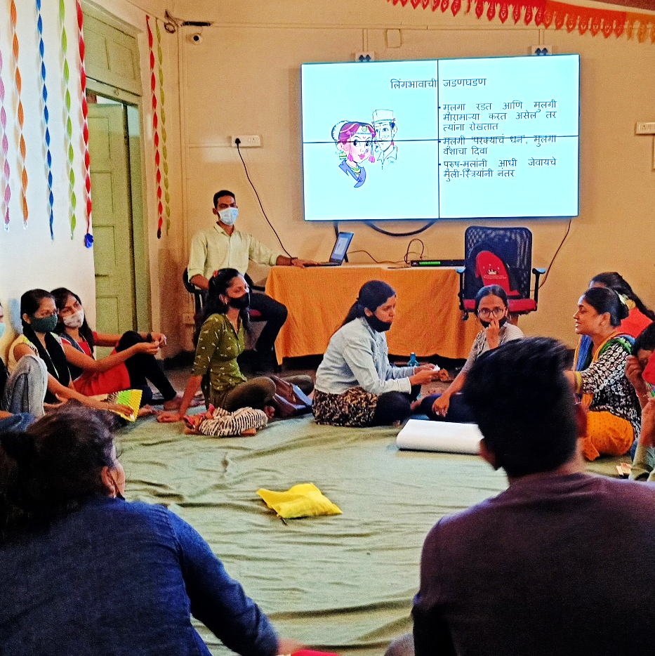
Project spotlight: Self defence and value education
Project Community: Pune, India
Project Aim:
To increase awareness and confidence among women for their safety.
What the team did:
Vishal Kokare the YIF holder taught women how to practice self defence (basic Karate steps). He taught a batch of men on basic etiquettes and values that men need to hold towards women.
Project Outcomes:
Approximately 40 men and women learned basic self-defence techniques, values towards women and took an oath to protect women and treat them with respect.
25

Slide 26
Project spotlight: Entrepreneurship and livelihood building among young women
Project Community: Pune, India
Project Aim:
To teach women artificial jewellery making skills which will allow them to earn a livelihood.
What the team did:
Rupali, and a trainer taught women how to make artificial jewellery for over one month.
Project Outcomes:
12 women learned artificial jewellery making skills and felt confident about self and enhanced their self worth.
26

Slide 27
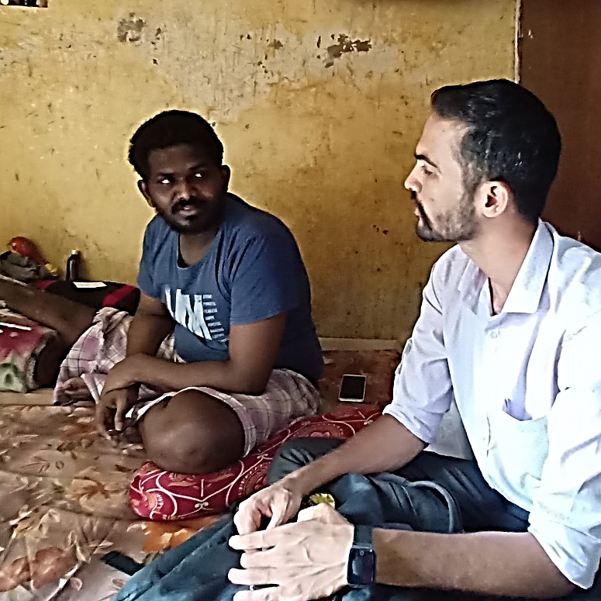
Project spotlight: Understanding and creating livelihoods for differently abled youth
Project Community: Pune, India
Project Aim:
To enable differently abled youth to gain skills to secure jobs.
What the team did:
Identified a set of 40 differently abled youth through snowballing technique, conducted home visits, built a relationship with families and sent the youth for job fairs.
Project Outcomes:
Next Steps:
Trust building with differently abled youth who felt neglected by city-based livelihood organisations. Youth attended job fairs and gained confidence in attending interviews. We learned how difficult it was for differently abled youth to break the structural barriers that stop them from securing jobs.
The shortlisted youth will be followed up by the Accenture Youth Connect team and connected to job opportunities. We will build linkages with ecosystem partners across the city who are willing to recruit differently abled youth.
27

Slide 28
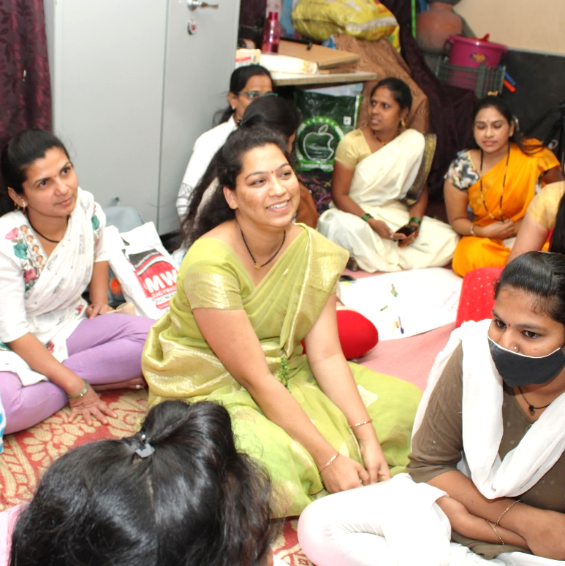
Project spotlight: Completing high school education for school drop out youth
Project Community: Pune, India
Project Aim:
To enable school drop out youth to complete high school education.
What the team did:
Built relationship with an extensive list of school drop-out students and with city-based organisations who support school drop-out students to complete high school education. Through this connection, students received tuition and appeared for exams.
Project Outcomes:
Next Steps:
40 school drop-out students completed high school education.
Youth Connect project has now taken over this project as a pathway enabling large-scale youth and organisational connections to support a large number of school drop-out students to complete high school education.
28

Slide 29

GOYN Youth Innovators
29

Slide 30


[Insert youth innovator name] – [insert community]
Name:
Skills
3 Skills you would like to develop from the YIF Programme
…
…
Interests/Hobbies
What are three of your hobbies
…
…
A cause that is important to you
Name a cause or a global challenge that is important to you
Fun Fact
Fun fact about yourself
Personal Summary
Share a bit about yourself. What do you do? Where do you see yourself in the future and what are some of your goals?
30

Slide 31


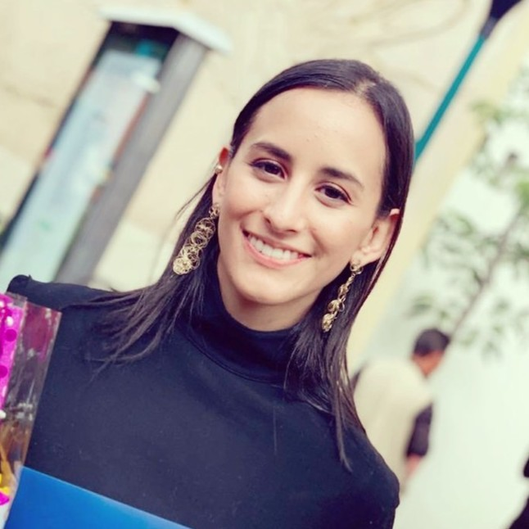


Diana Laura Zárate Rosales - Mexico
Diana Laura Zárate Rosales
Skills
Networking
Design Thinking
Data analysis
Interests/Hobbies
Bakery
Reading
Organizing things
A cause that is important to you
Fight inequality in my country.
Fun Fact
I have two rescue dogs
Personal Summary
I’m interested in social impact projects, particularly in Mexico since I’m passionate about my country and its culture and traditions.
In the future I see myself involved in social impact projects, making a better country for future generations.
31

Slide 32


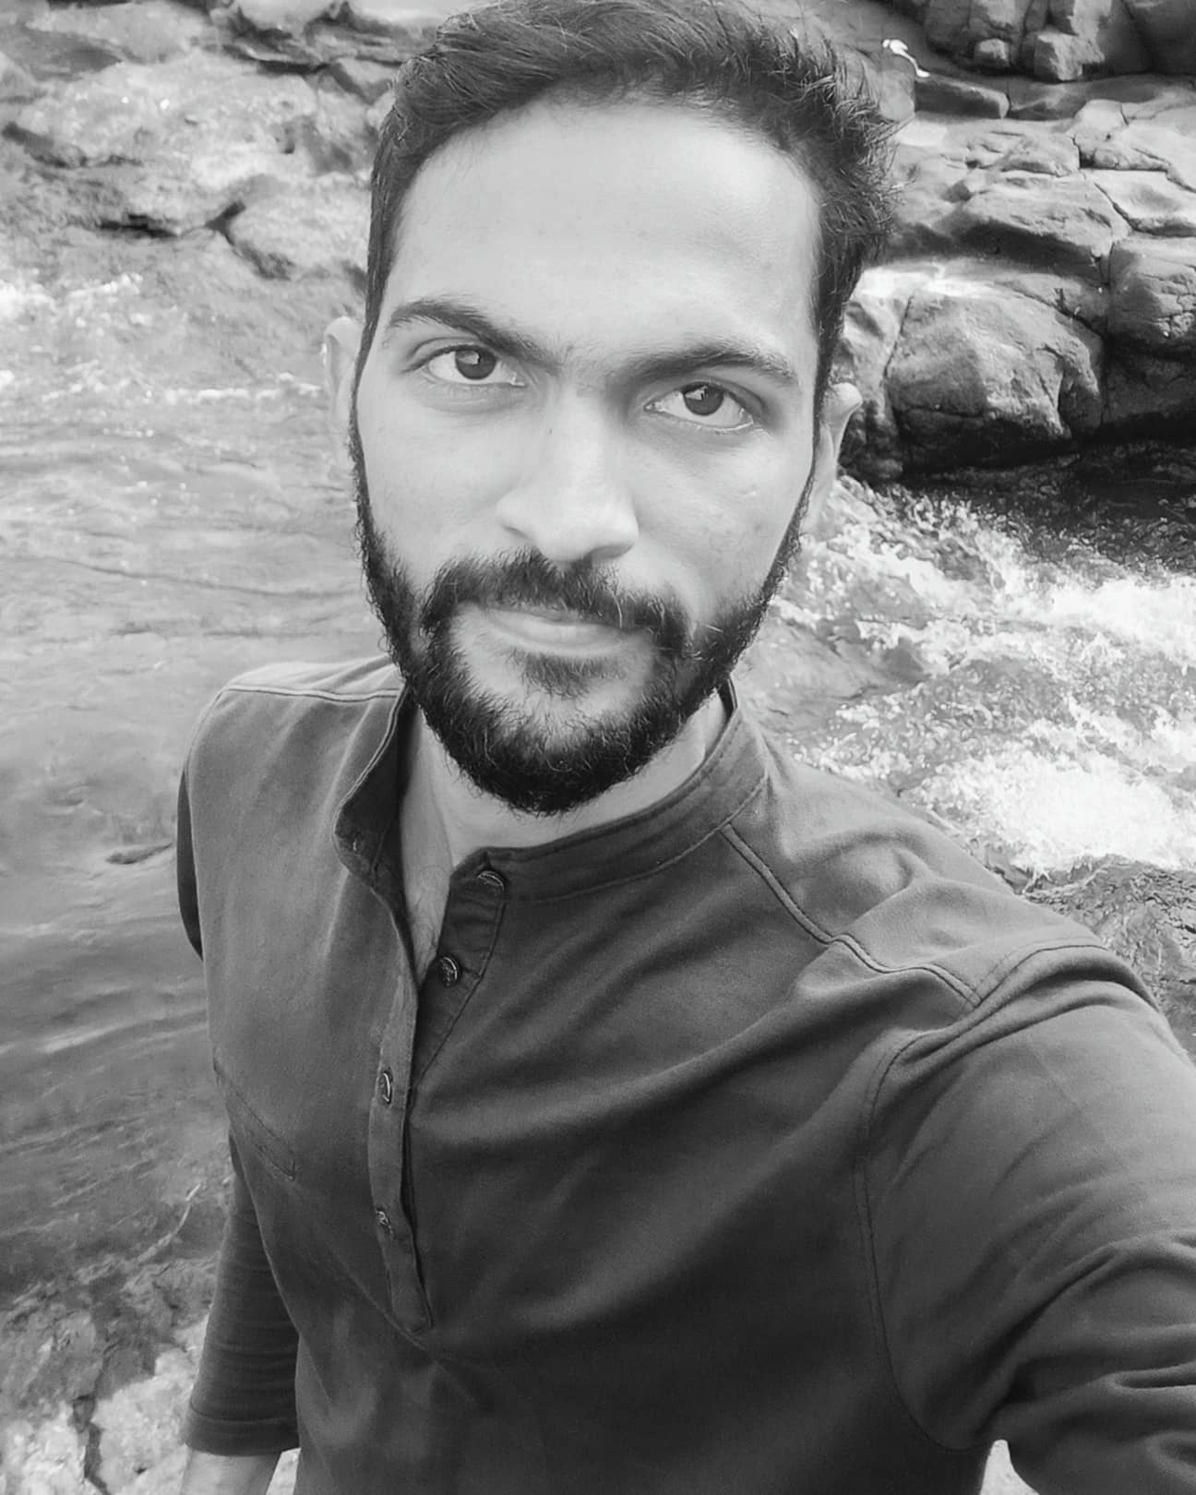


Vishal K. - Pune
Vishal K.
Skills
Project Management
Leadership
Interests/Hobbies
Trekking
Rock climbing
Reading Books
A cause that is important to you
Job preparedness for youth and security awareness for women
Fun Fact
On weekends you'll find me somewhere in Sahyadri mountains.
Personal Summary
I believe in learning process. I love outdoor activities and am passionate towards social causes. Currently I'm focused on career in corporate sector, taking global projects exposure and learning about the project operations. I see myself launching a free self defence and gender equality centre. Along with this center will provide right guidance and job preparedness sessions to youths.
32

Slide 33
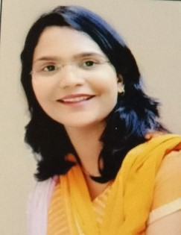
Rupali Wadekar – Pune
Rupali Wadekar
Skills
Public speaking
Fresh skill development
Networking
Interests/Hobbies
Reading suspense story books
I like to write in my handwriting
Cooking
A cause that is important to you
Youth Empowerment
Fun Fact
I know how to speak 3 languages and I am currently learning my 4th
Personal Summary
I am studying LLB (Law) final year and am from Pune. I work with youth from 13-30 years of age. I share my opinion with youth and try living by my standards. I try to encourage others and give them guidance as needed.
33

Slide 34
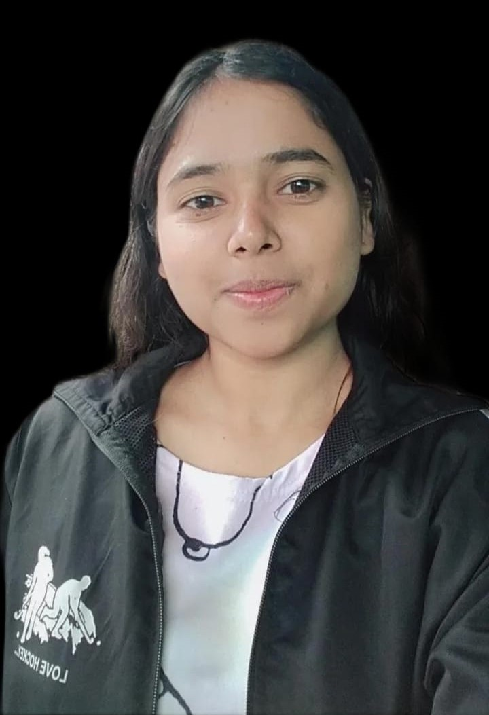
Prerna Ovhal – Pune
Prerna Ovhal
Skills
Understanding all the tools and work on them .
I want to learn a new skills .
I want to excel in my soft skills Interests/Hobbies
Playing out door game's ( I have played hockey at district level)
I love to wander in nature
I like to gather knowledge about current technology and history
A cause that is important to you
Child labor
Fun Fact
Earlier, I used to hate cooking. But now I cook appetizing delicacies.
Personal Summary
I am a good observer. I always observe the situation and then manage it well . I am empathetic and patient and have strong organisational skills. I always strive to give my best in my work. I see myself guiding a lot of people on this career path. And with time, we will have a lot of success stories which will inspire next generation people around us.
34

Slide 35
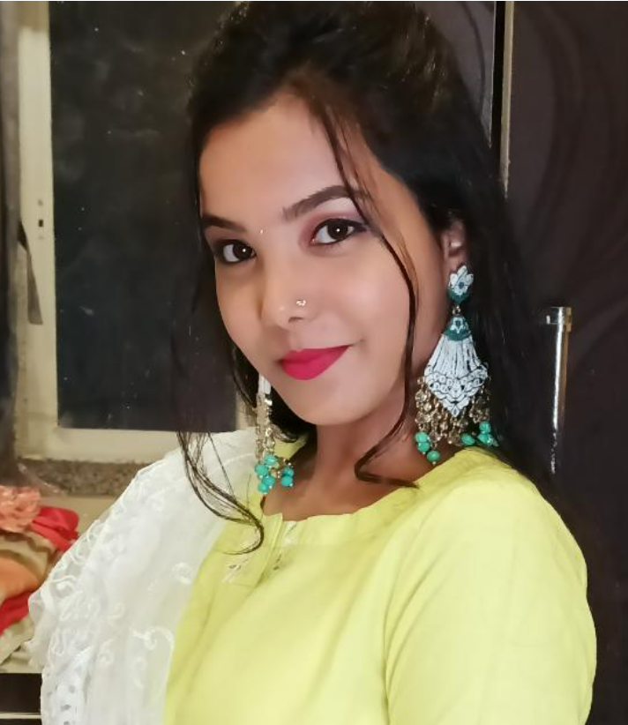
Shweta Patil – Pune
Shweta Patil
Skills
Create different makeup looks
Applying mehandi designs (Practice of making designs on someone's hands with henna (= a reddish-brown dye))
Cooking
Interests/Hobbies
Women’s rights
Peoples point of view about differently abled community
A cause that is important to you
I can learn different things quickly
Fun Fact
I am good at public speaking.
Personal Summary
I am not able to get comfortable very quickly in different places. But I like to meet people and hear about their good and bad experiences. Also I must do something in life that encourages handicap people and motivates them to act.
35

Slide 36
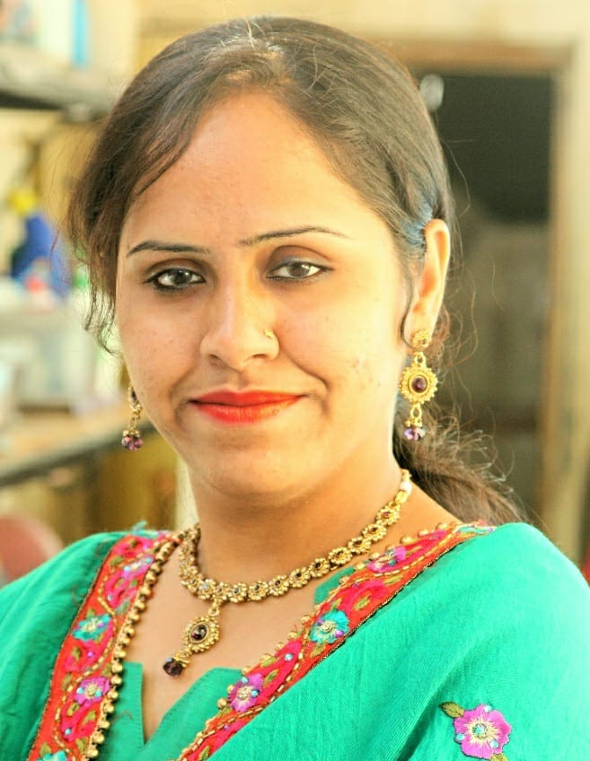
Aasiya Mohammad Zaheer Shaikh - Pune
Aasiya Mohammad Zaheer Shaikh
Skills
Mobilizing large number of youth using Whatsapp Status and social media
Solving youth challenges via YIF
Interests/Hobbies
Interacting with people
Travelling
Helping people
A cause that is important to you
Women's safety
Eve teasing
Unemployment
Fun Fact
No matter how much pain I am enduring, I go out all the way to help people who seek support. Thus I forget my pains and derive joy that I am of use to someone.
Personal Summary
I like social work. I got multiple opportunities to help youth via the Youth Innovation Fund. My desire is to stay connected with such opportunities to help people. I desire to be known as a Social Worker who is of help to others.
36

Slide 37

Shivam Patidar - Barwani
Skills
Global Level Youth Network.
Problem solving and Solution maker.
Advising Skills from Design Thinking Toolkit.
Interests/Hobbies
Management
Dance, Kabaddi and Business Classes
Learning New Things.
A cause that is important to you
Encouraging our Youths to learn new skills and work for their dreams from Teen-age.
Fun Fact
I thinks that to become good in every field is difficult but I want to become an all rounder.
Shivam Patidar
Personal Summary
I really like to meet new people and want to know about their story as well as their work. I enjoy learning new things and want to learn about different fields as much possible. I always try to learn new skills and formal knowledge. I have interest in Bbusiness ideas and want to start some of them. I always try to work with senior people.
37

Slide 38
Shivansh Vikram - Ramgarh
Shivansh
Vikram
Skills
Active Listening
Project Planning
Time Management
Interests/Hobbies
Listening Music
Watching Web Series
Playing Cricket
A cause that is important to you
Youth Unemployment
Fun Fact
I like to observe people.
Personal Summary
I enjoy traveling to new places and meeting new peoples of different communities. Currently I’m associated with GOYN Ramgarh as a YAG Member.
In the coming few years I want to see myself in a formal job in a well organized sector where I have job security and through that job, I can help other people as well.
38

Slide 39
Rajab Salim - India
Rajab Salim
Skills
Networking
Understanding Design Thinking
Decision making
Interests/Hobbies
Writing poetry
Travelling
Movies
A cause that is important to you
Championing for youth inclusion and participation in decision making processes.
Fun Fact
I was born a premature baby
Personal Summary
I love to volunteer my time, talent and expertise in my community because of the constant human interaction and the satisfaction that comes with helping people solve problems.
I see myself running for office as a member of parliament or Governor.

Slide 40
A note of appreciation
In order to develop the YIF Design Thinking Toolkit, we went through a Co-Creation and Pilot process with 3 Anchor Partners a 15 youth innovators.
A big thank you to the following GOYN communities for all of their contributions in co-creating and piloting the Design Thinking Toolkit:
Mexico City
Sao Paolo
Mombasa
Pune
Ramgarh
Barwani
40

