Slide 1

Community Site Implementation Guide

Slide 2


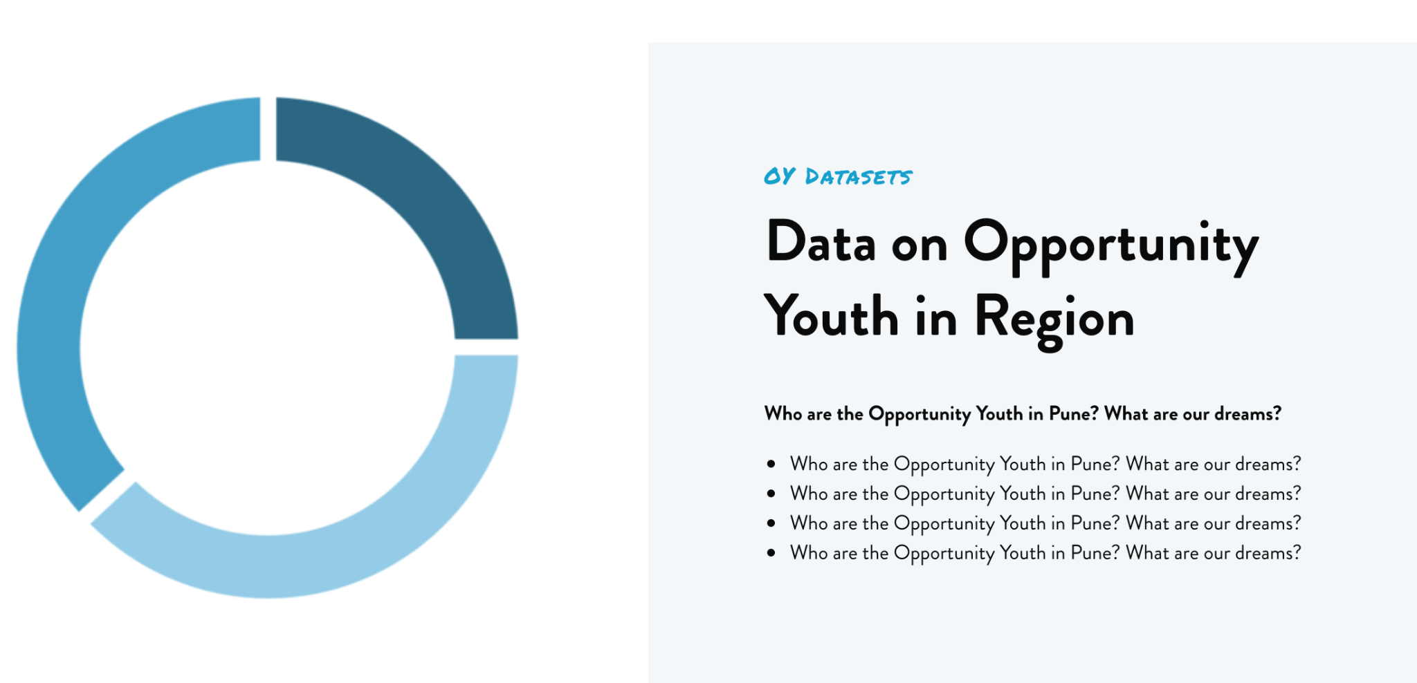
The GOYN Community Site Template is a resource for all GOYN communities wherein communities can connect directly with OY
Connect OY to directly to local resources
Share key insights with partners and beneficiaries

Slide 3
Set-Up Instructions
Choose a hosting platform for your site
Choose and reserve a domain name (make sure that the URL you select is concise and relevant)
Download the theme zip from the Drive link and set-it up on the hosting platform you've each selected
Replace the server's plugins folder with the one in the plugins zip from this Drive link
Perform a "search and replace" function within the codebase and replace the url
"goyncom.wpengine.com" with the URL you've chosen
Follow the User Guide HERE to modify and update content, layout, images etc.

Slide 4
Additional Tips and Resources
Consider applying for the Google AdGrant Program. If eligible, you can receive up to $10,000 in free advertising to your site
It is highly recommended to hire a developer for the initial set-up of the site to ensure full and smooth functionality.
Collaborate with other communities to get an idea of the different ways you caen leverage the community site to meet the needs of OY

